Slide 1

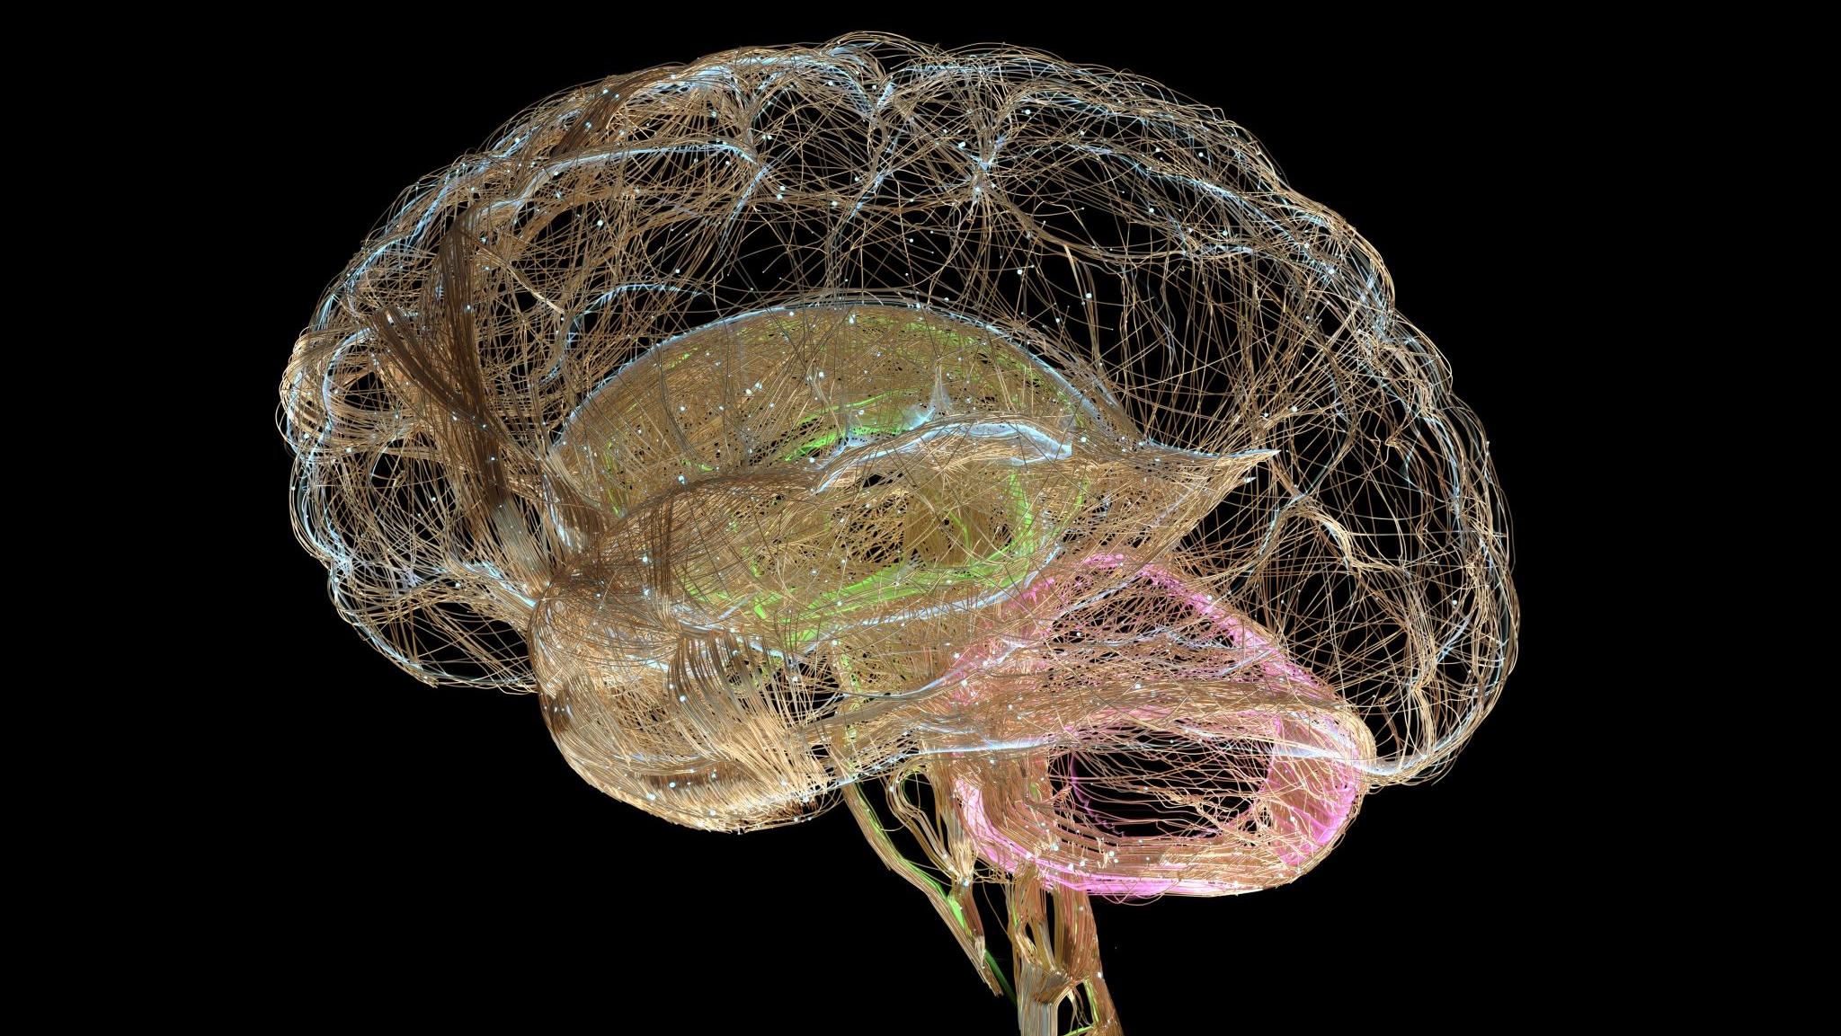
Intersection of Genetics and Brain Imaging Features for Neuropsychiatric Disorders

Slide 2
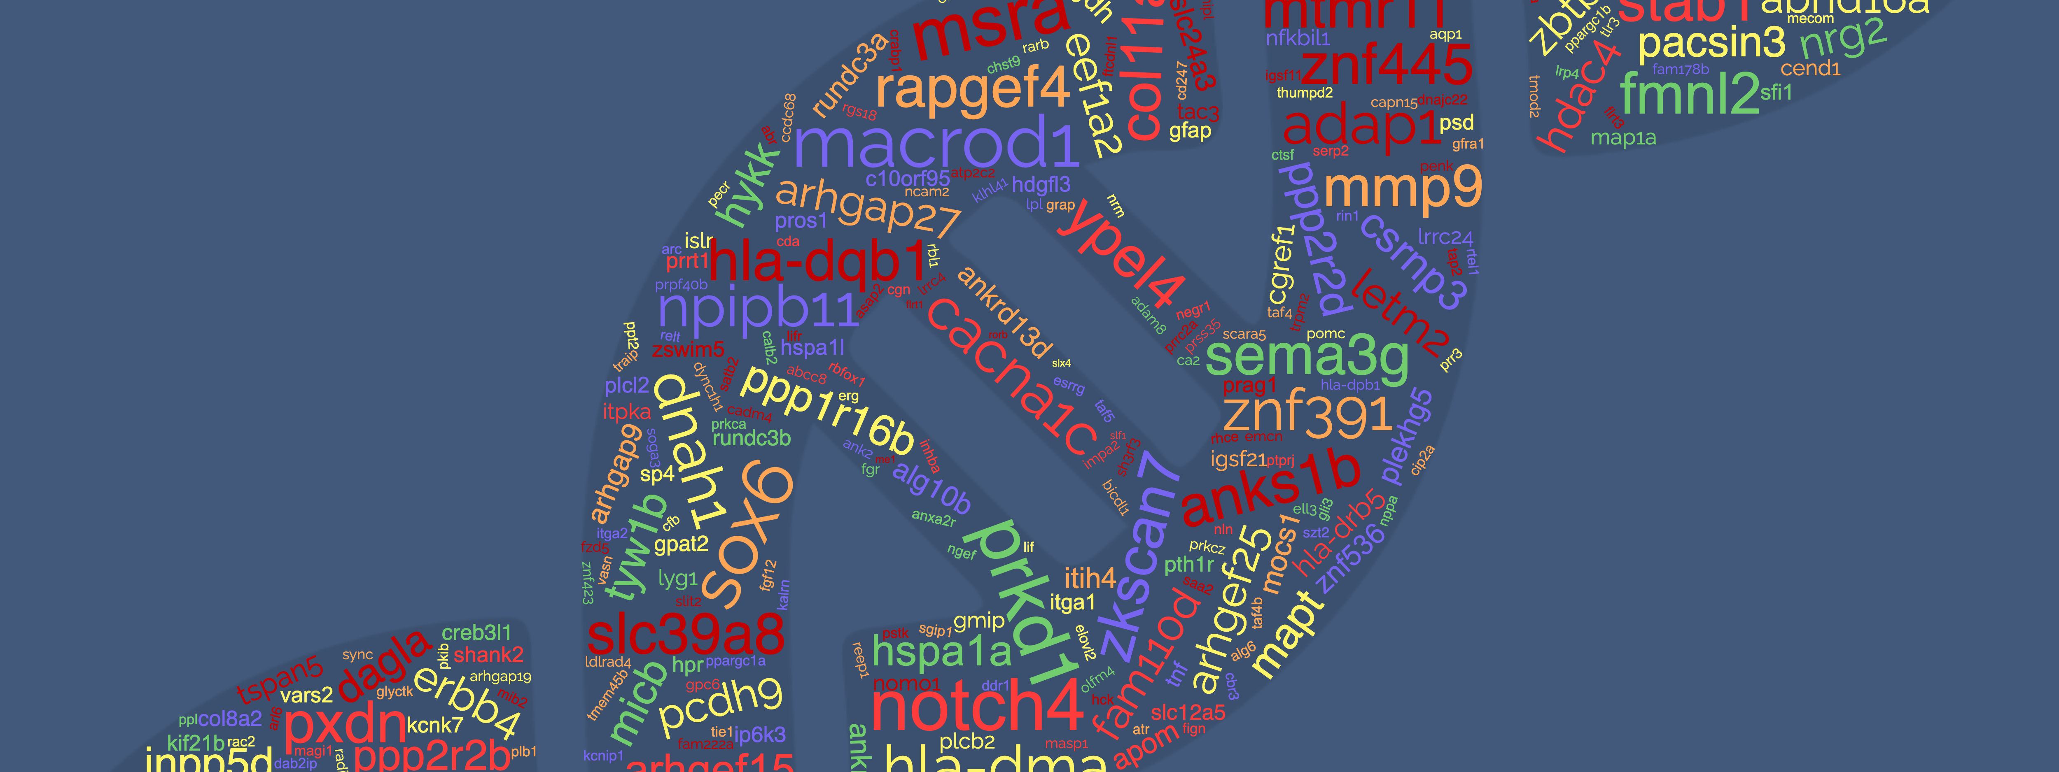
Outline
Hypotheses and Aim
Workflow overview
TWAS Analysis
TPRS Estimation
Results
Conclusion

Slide 3
Project Hypotheses and Aim

Slide 4
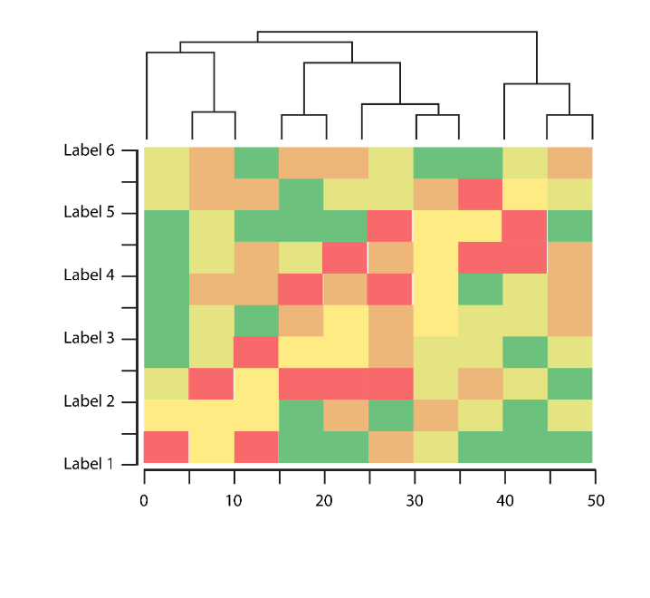
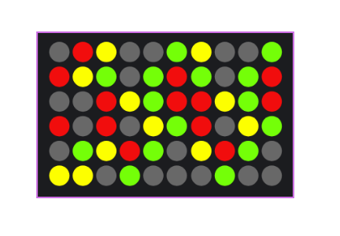
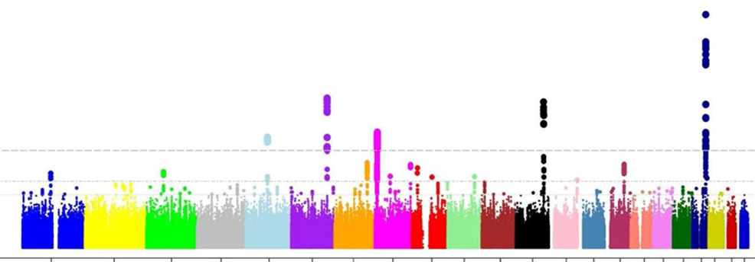
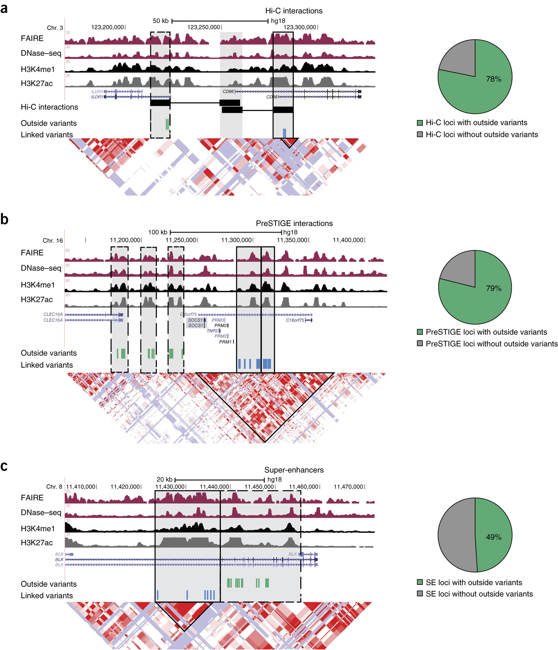

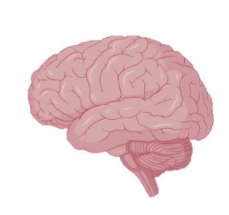

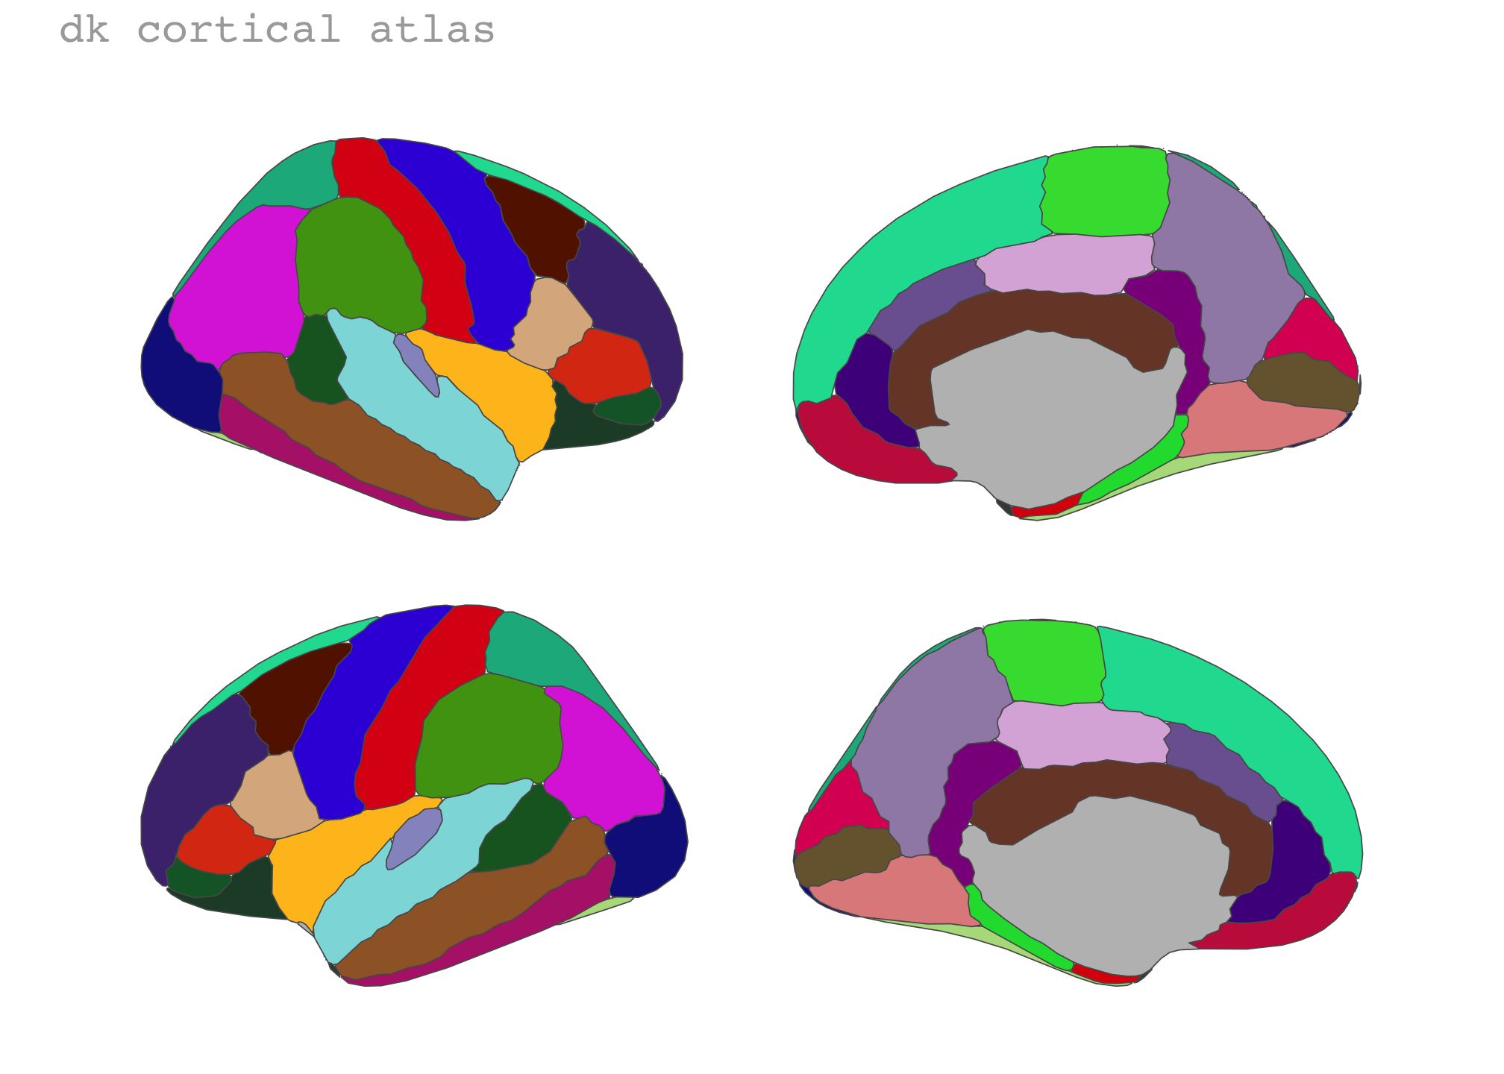
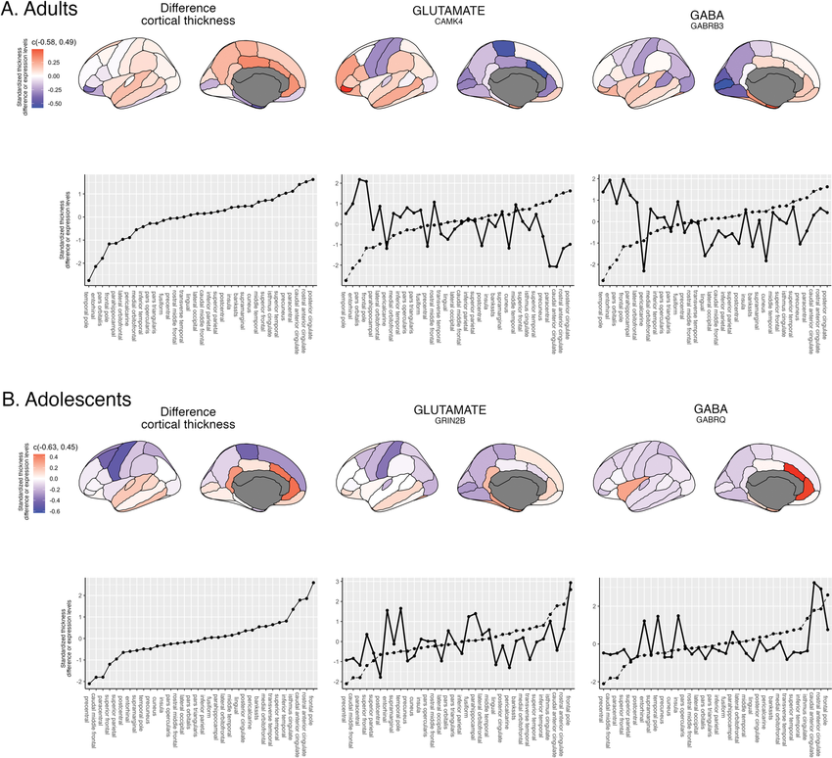
WORkflow
Genome-wide association data
Psychiatric Genomics Consortium (GWAS summary stats)
Post-GWAS functional fine mapping
(H-MAGMA)
GWAS Risk genes
Mapping tissue samples
to individual MRI and assignment to the DK atlas
Microarray expression
at anatomical resolution
Disorder 1
Gene i
Disorder 1
DK atlas
Disorder i
3-D modelling of chromatin interactions based on epigenetic data from the adult brain
Disorder i
Six healthy donors
Left only
SNP-level
Gene-level
Filtering for brain expression based on the human protein atlas
Gene i
Disease-related brain maps in neuroimaging space
Region i
Gene i
region i
Top genes only
(simple average)
Disorder 1
Transcriptome-wide normative gene expression mapped into a neuroimaging space
Disorder i
Region i
Gene i
Gene weights
region i
=
X
-log(p)
Disorder i
Whole transcriptome
(weighted average)

Slide 5
TWAS PREDICTION
From GWAS to TWAS

Slide 6
TWAS ANALysis Predixcan and Multixcan

Slide 7
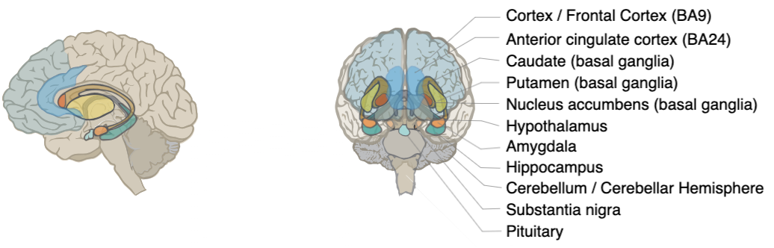
TWAS Prediction MODELS Sampling sites
Sampling sites used to generate GTEx elastic net prediction models (total of 11 models)

Slide 8
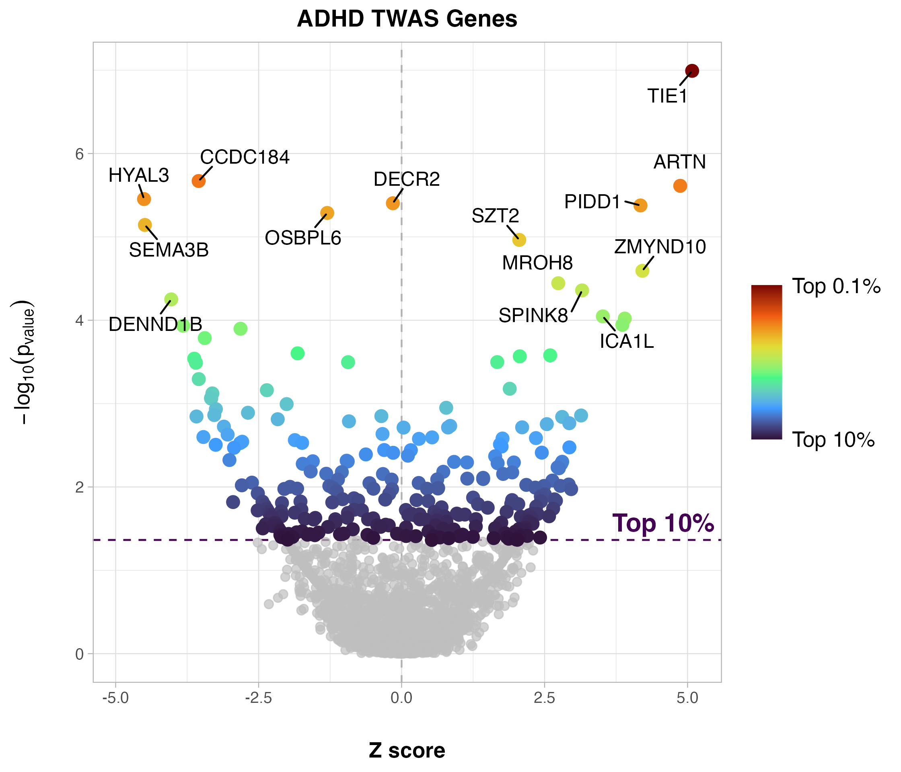
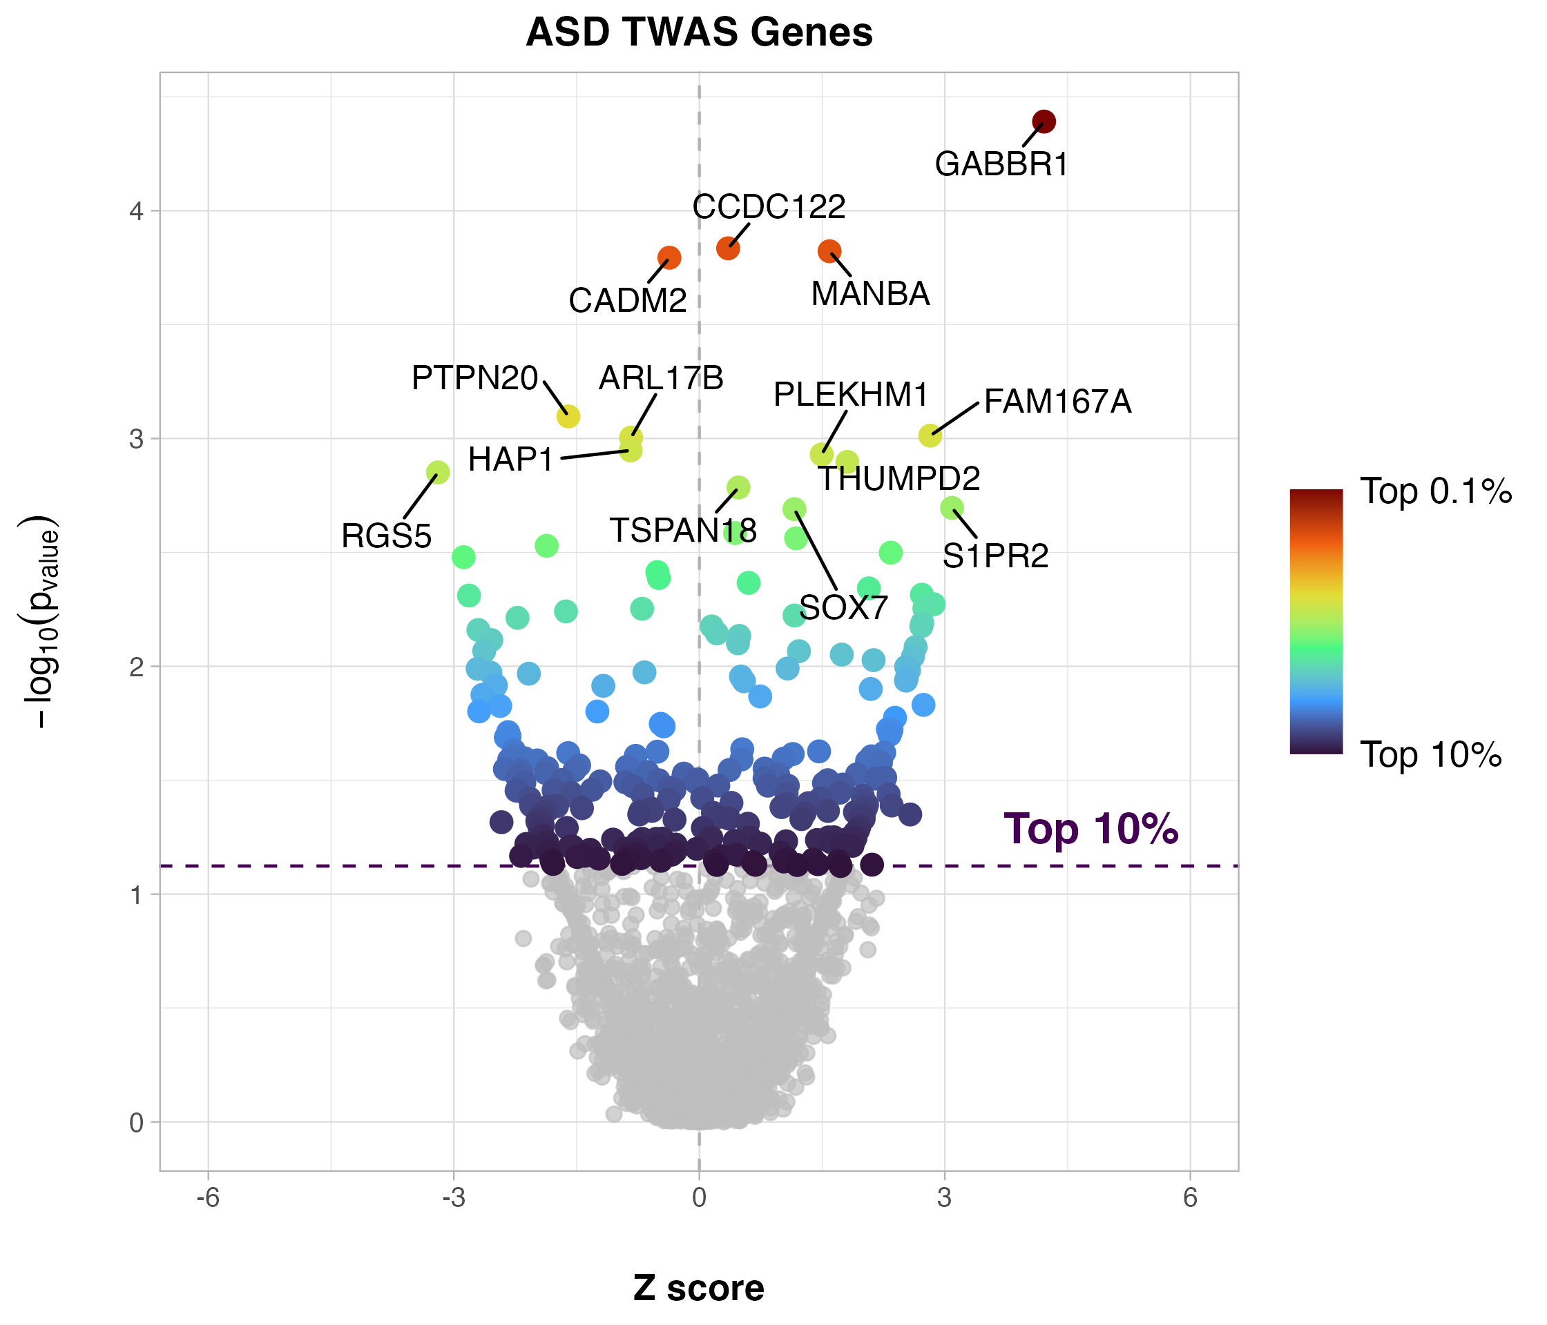
TWAS Genes Results
N = 2759
N = 2767

Slide 9
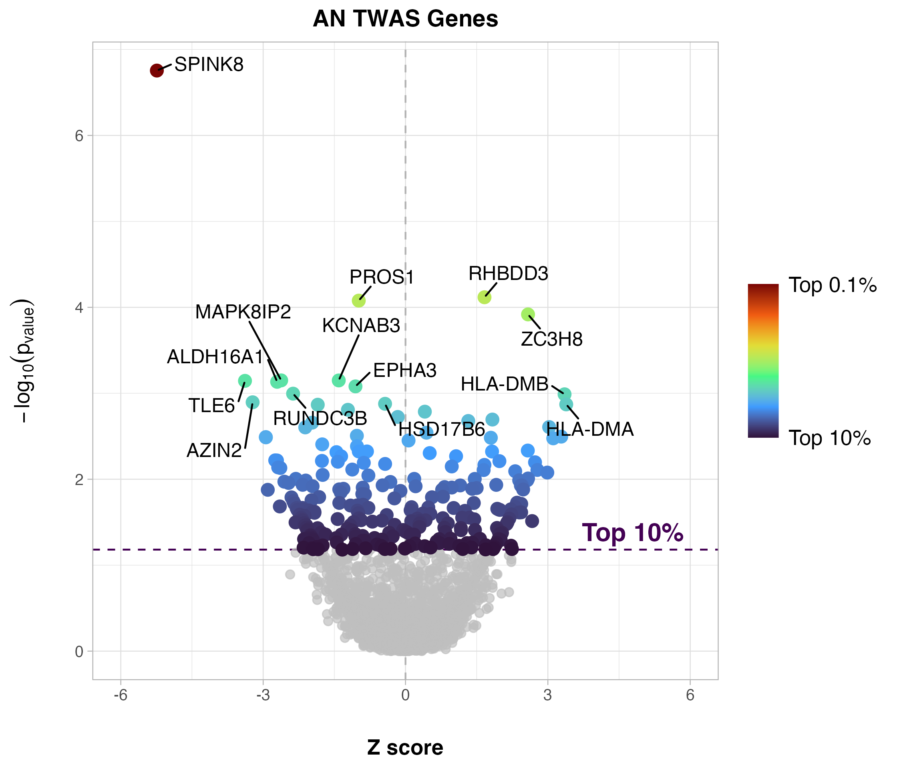
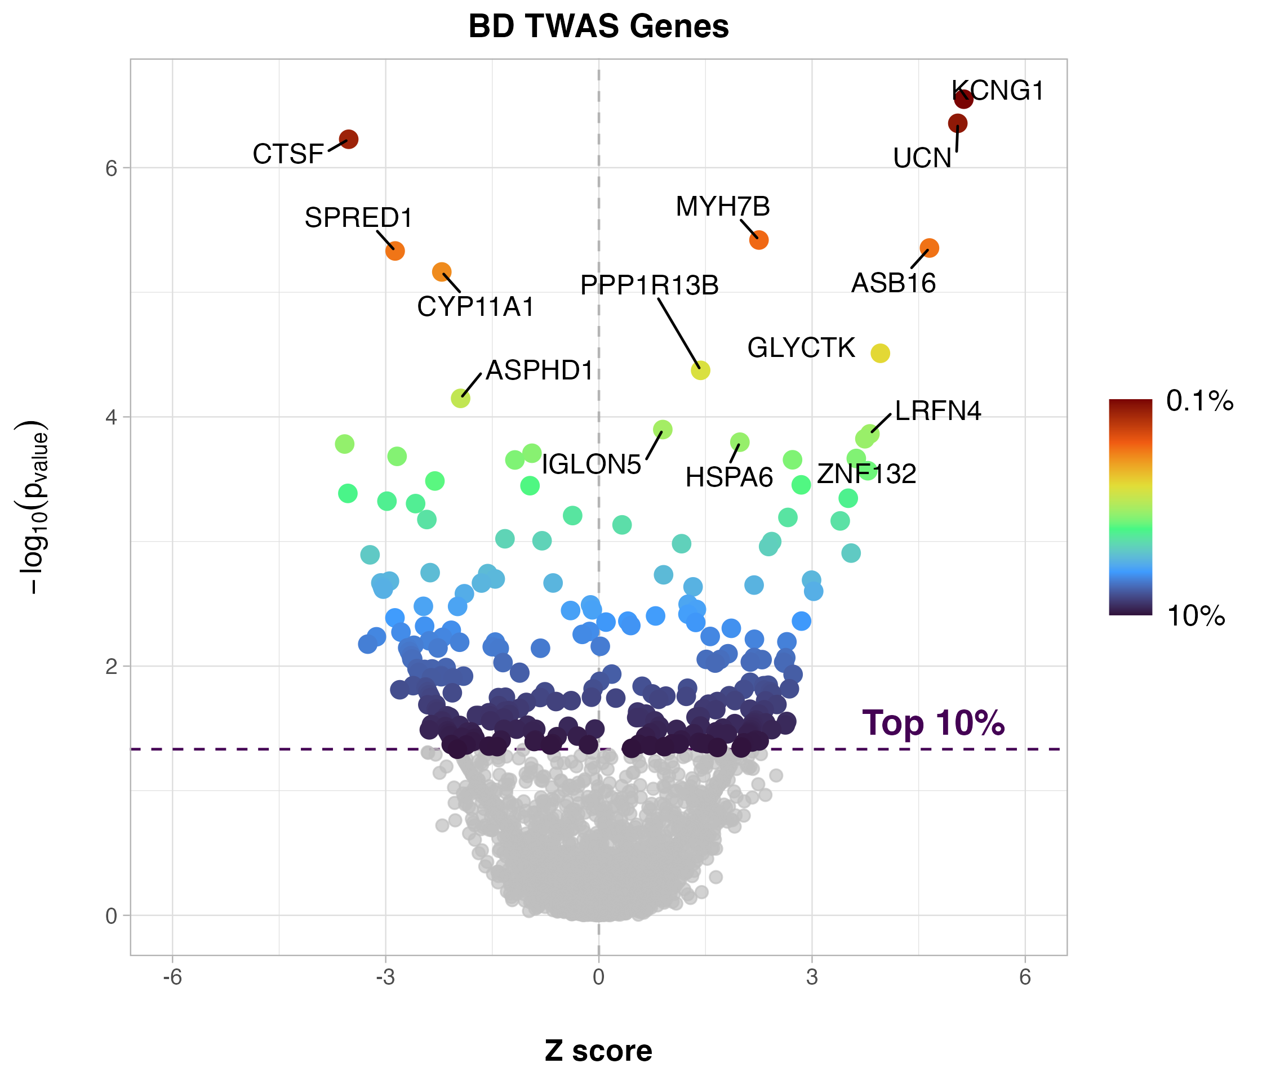
TWAS Gene Results
N = 2763
N = 2767

Slide 10
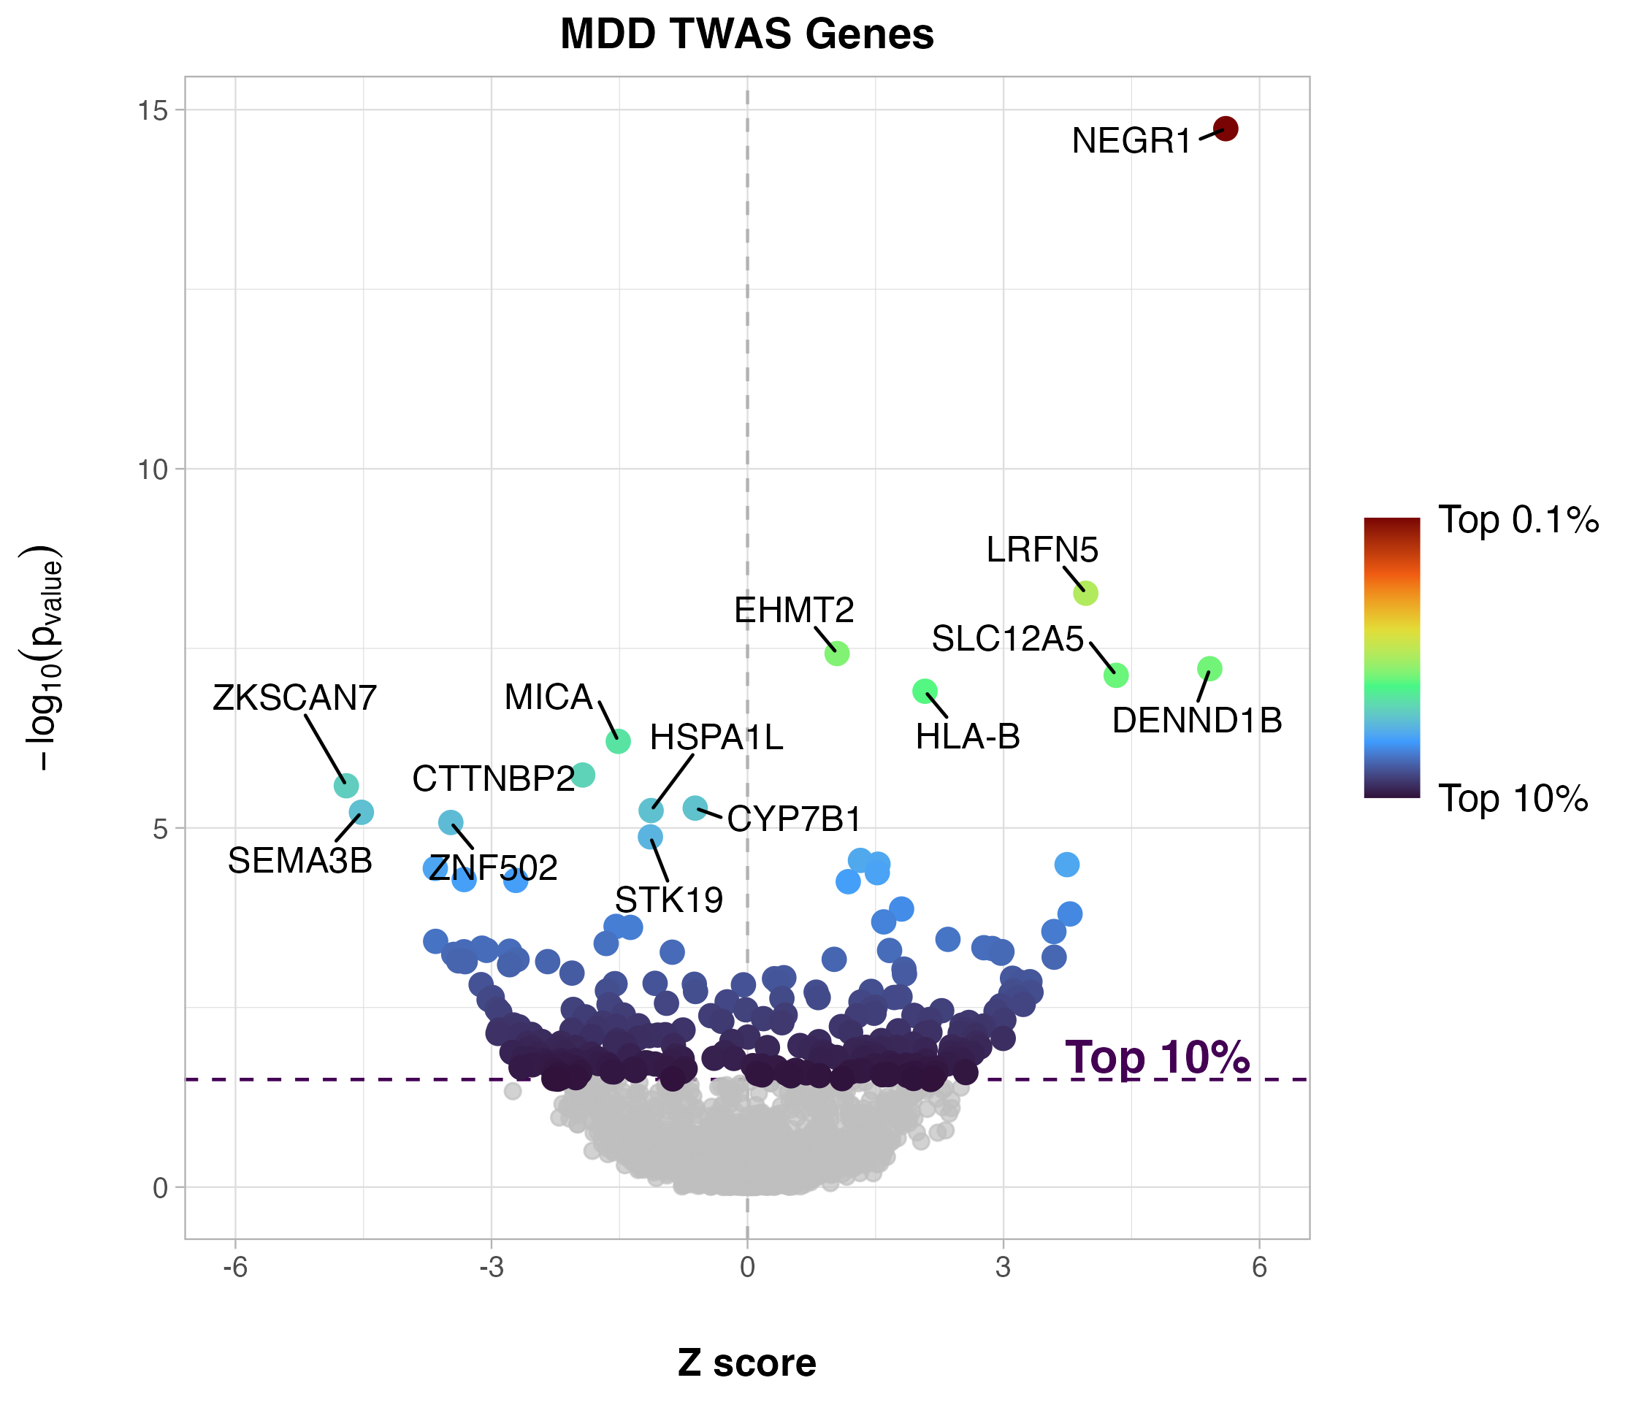
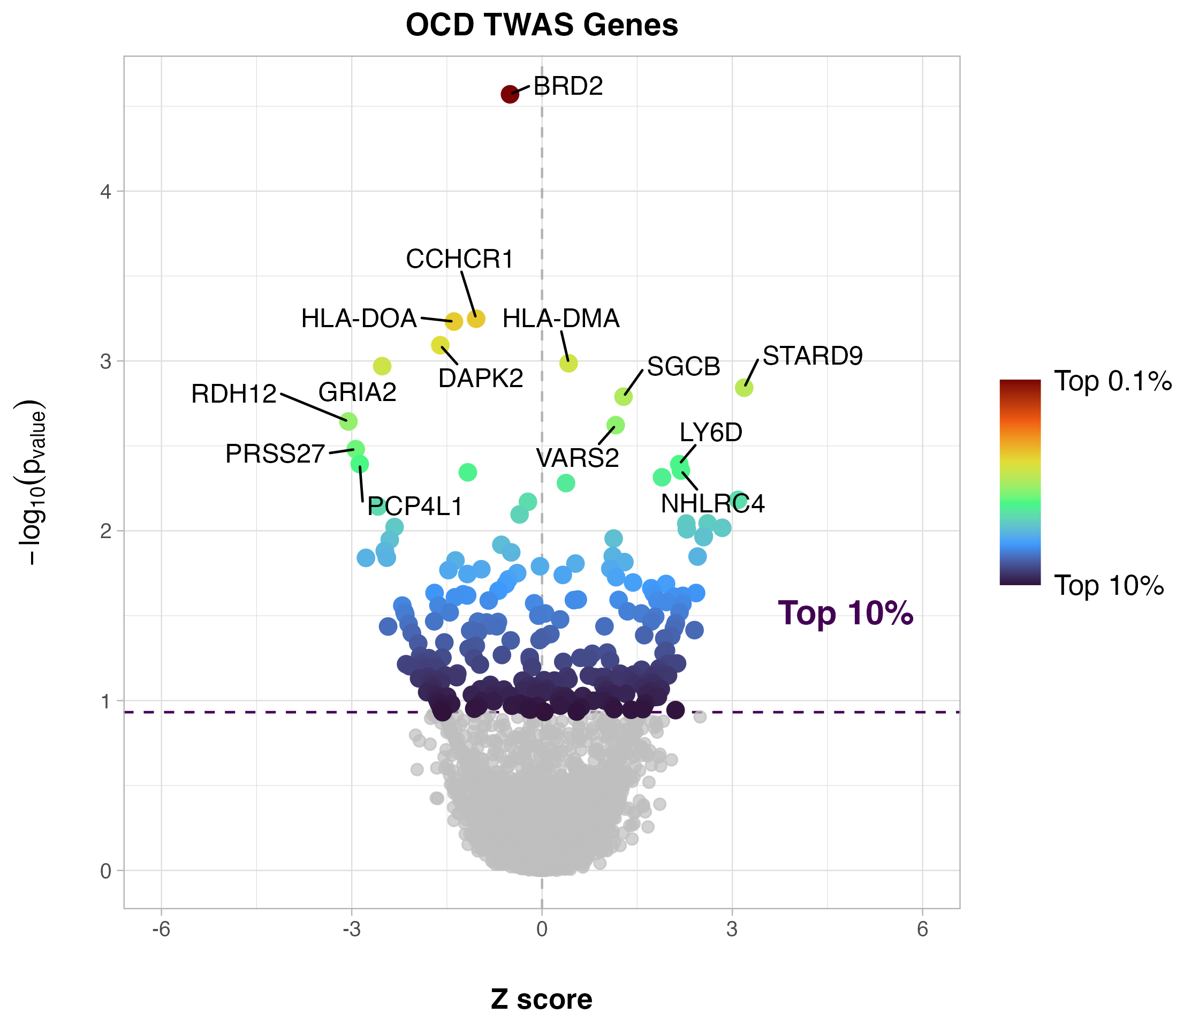
TWAS Gene Results
N = 2764
N = 2764

Slide 11
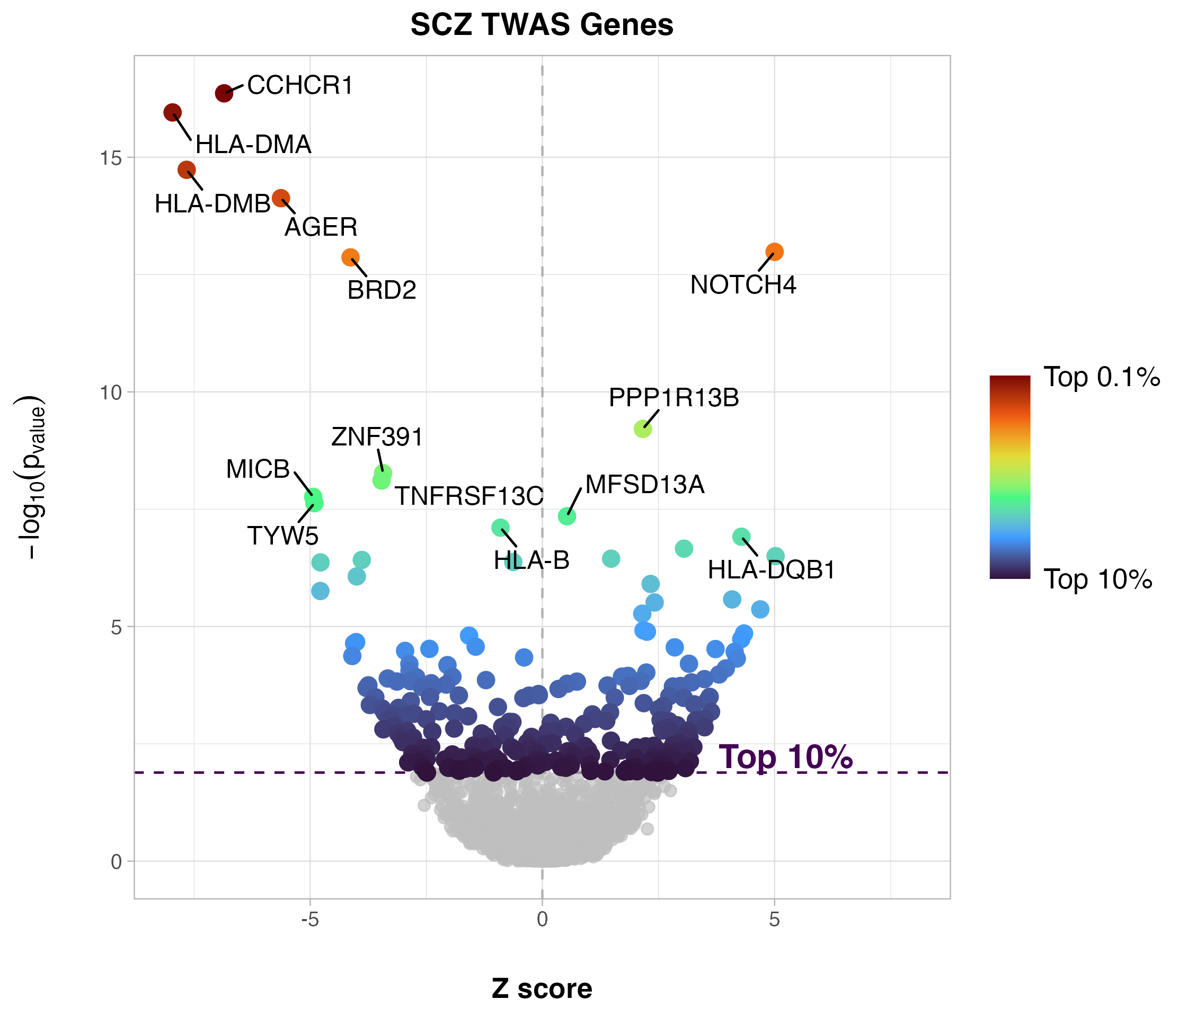
TWAS Gene Results
N = 2768

Slide 12
TPRS Estimation

Slide 13
TPRS SCORE Calculation and thresholds

Slide 14
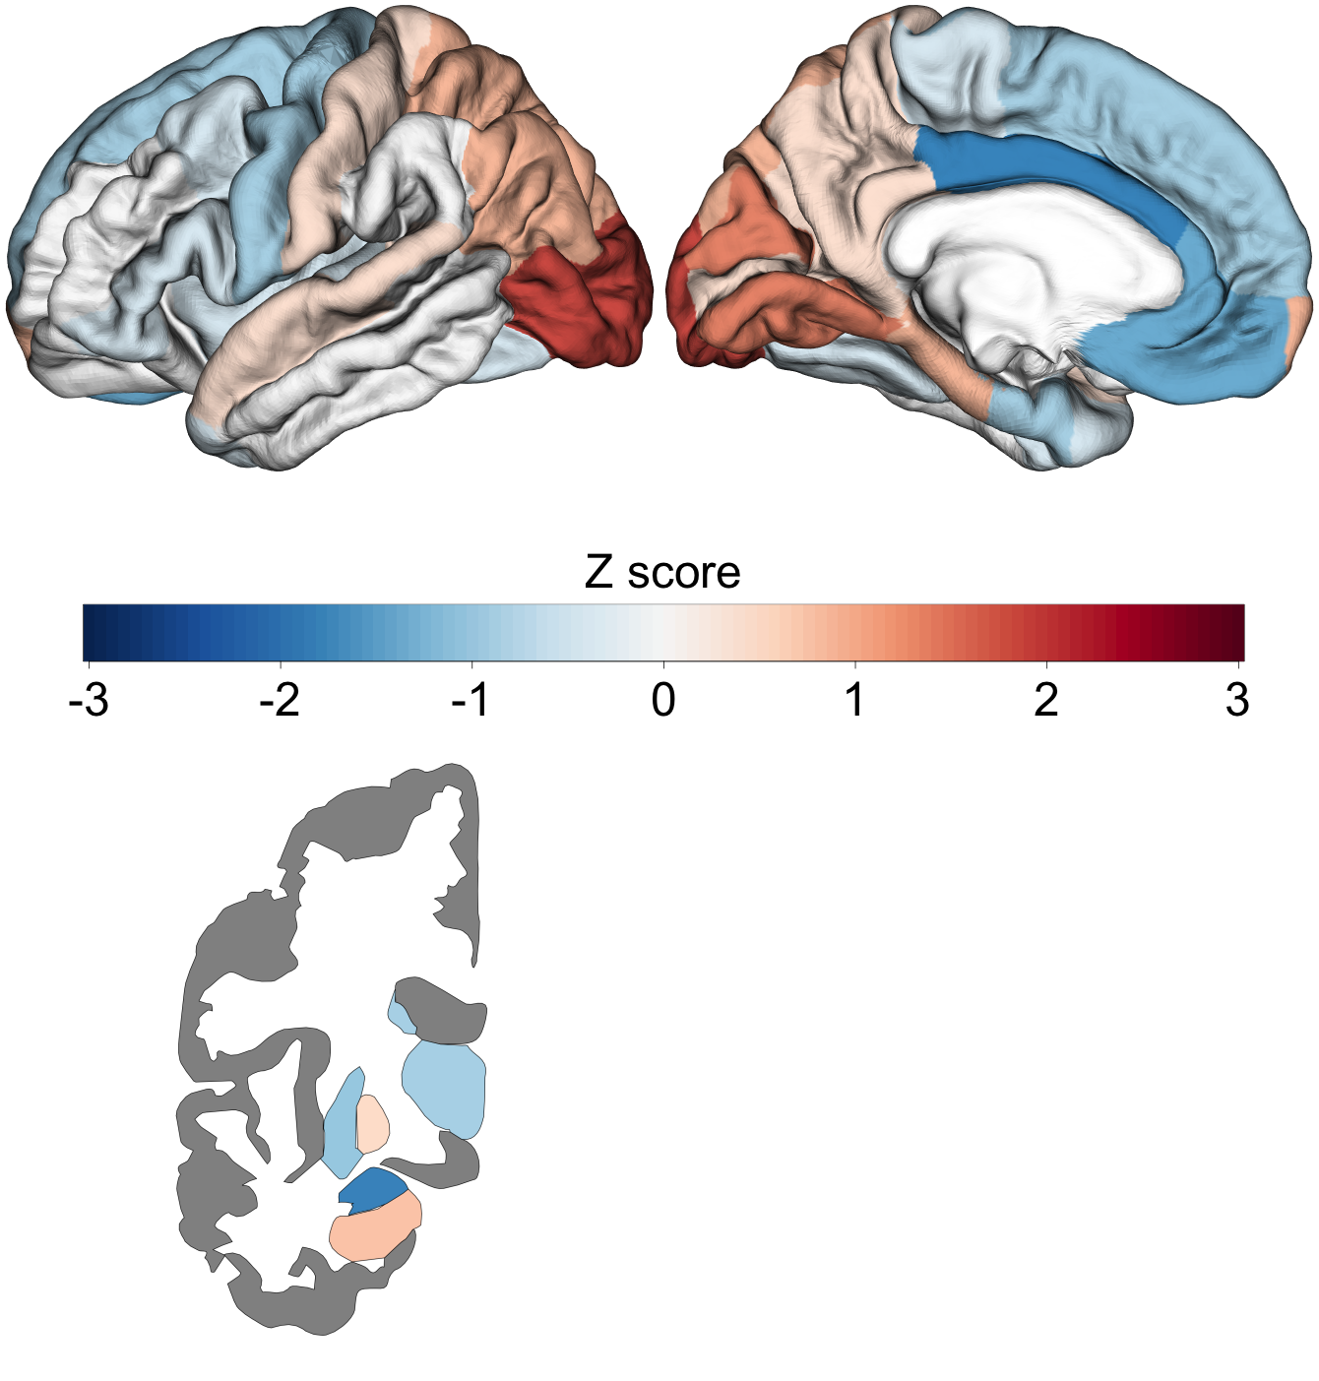
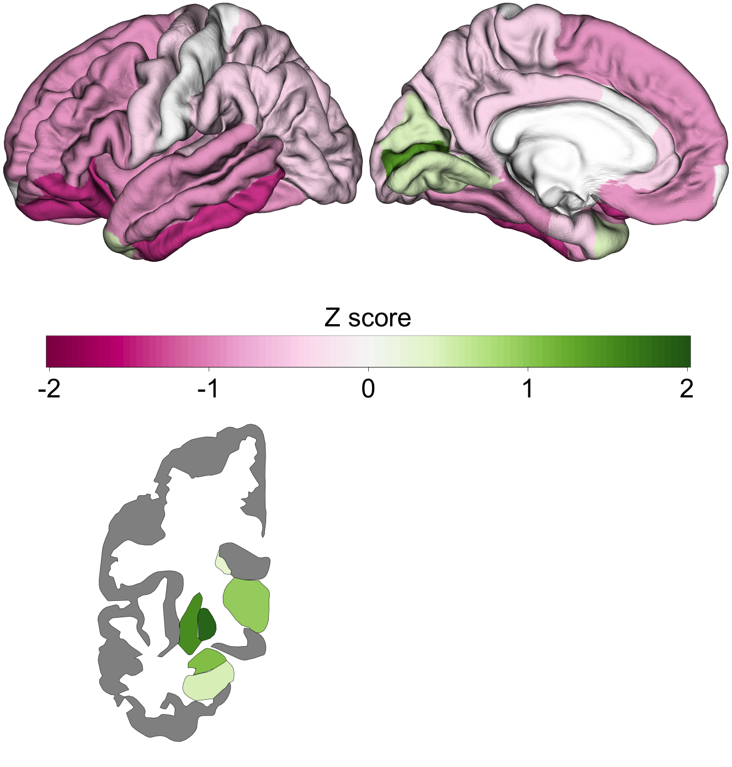
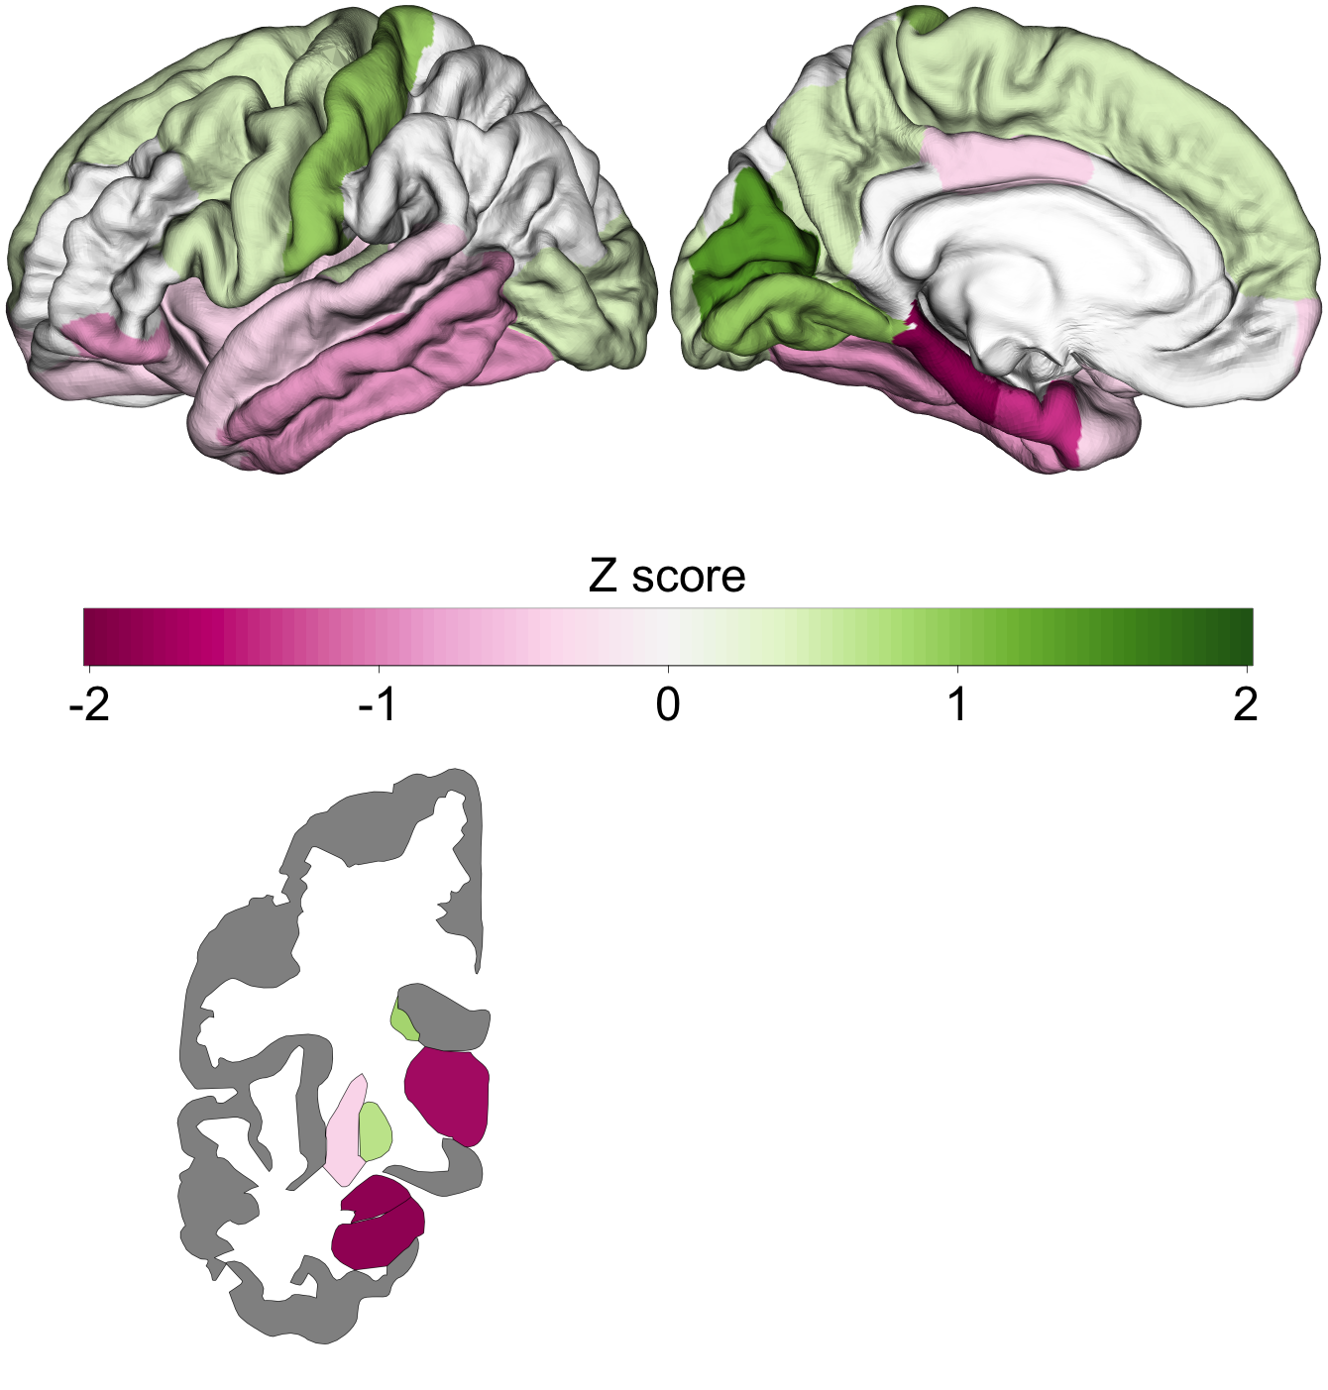
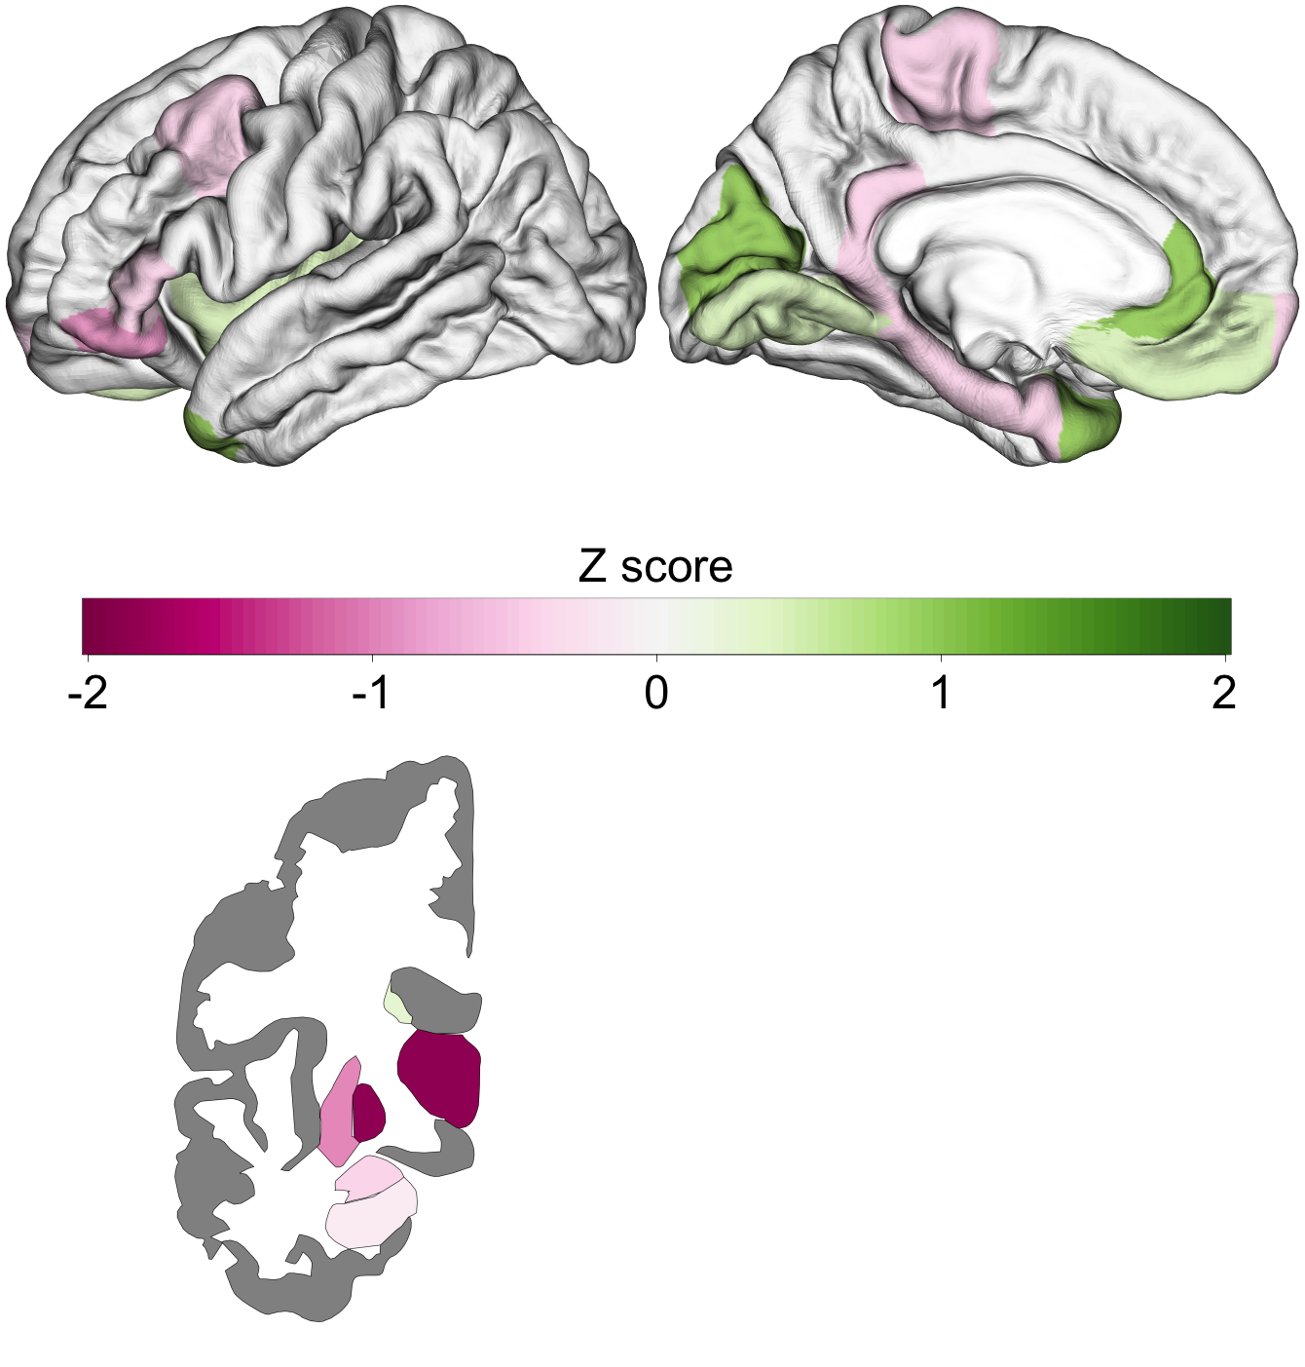
ADHD – UP- & Down-Regulated genes
Enigma Cohen’s d
Gene Expression TPRS Score
10%
5%
1%

Slide 15
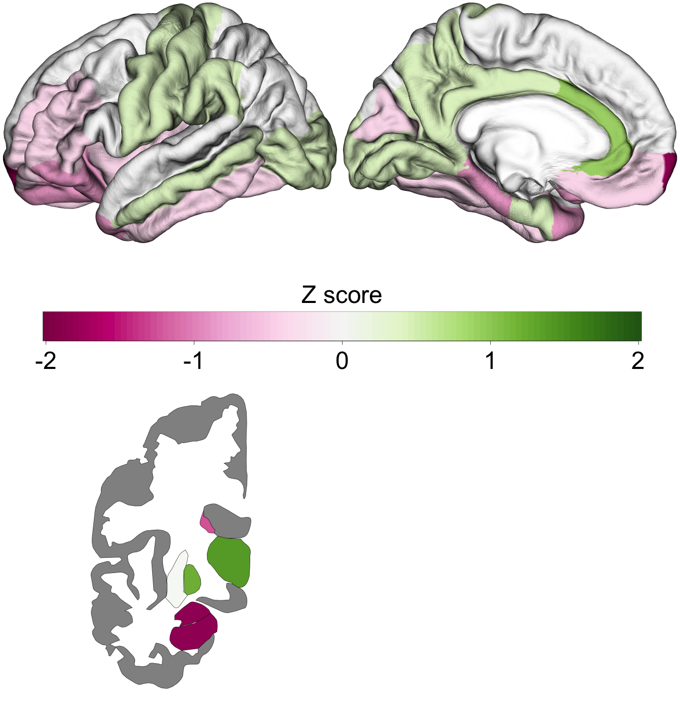
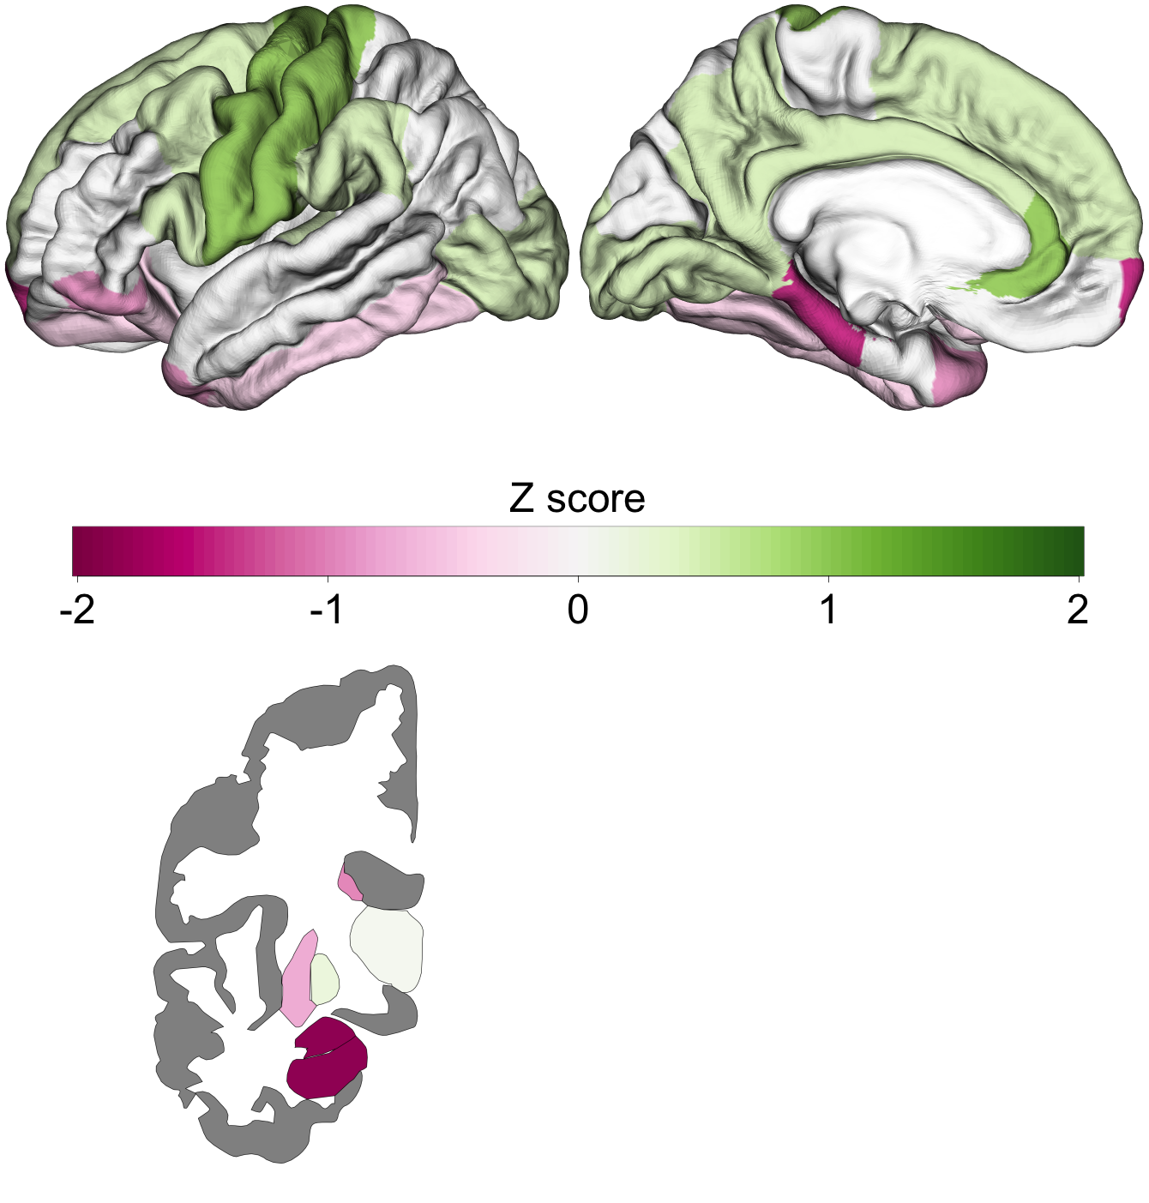
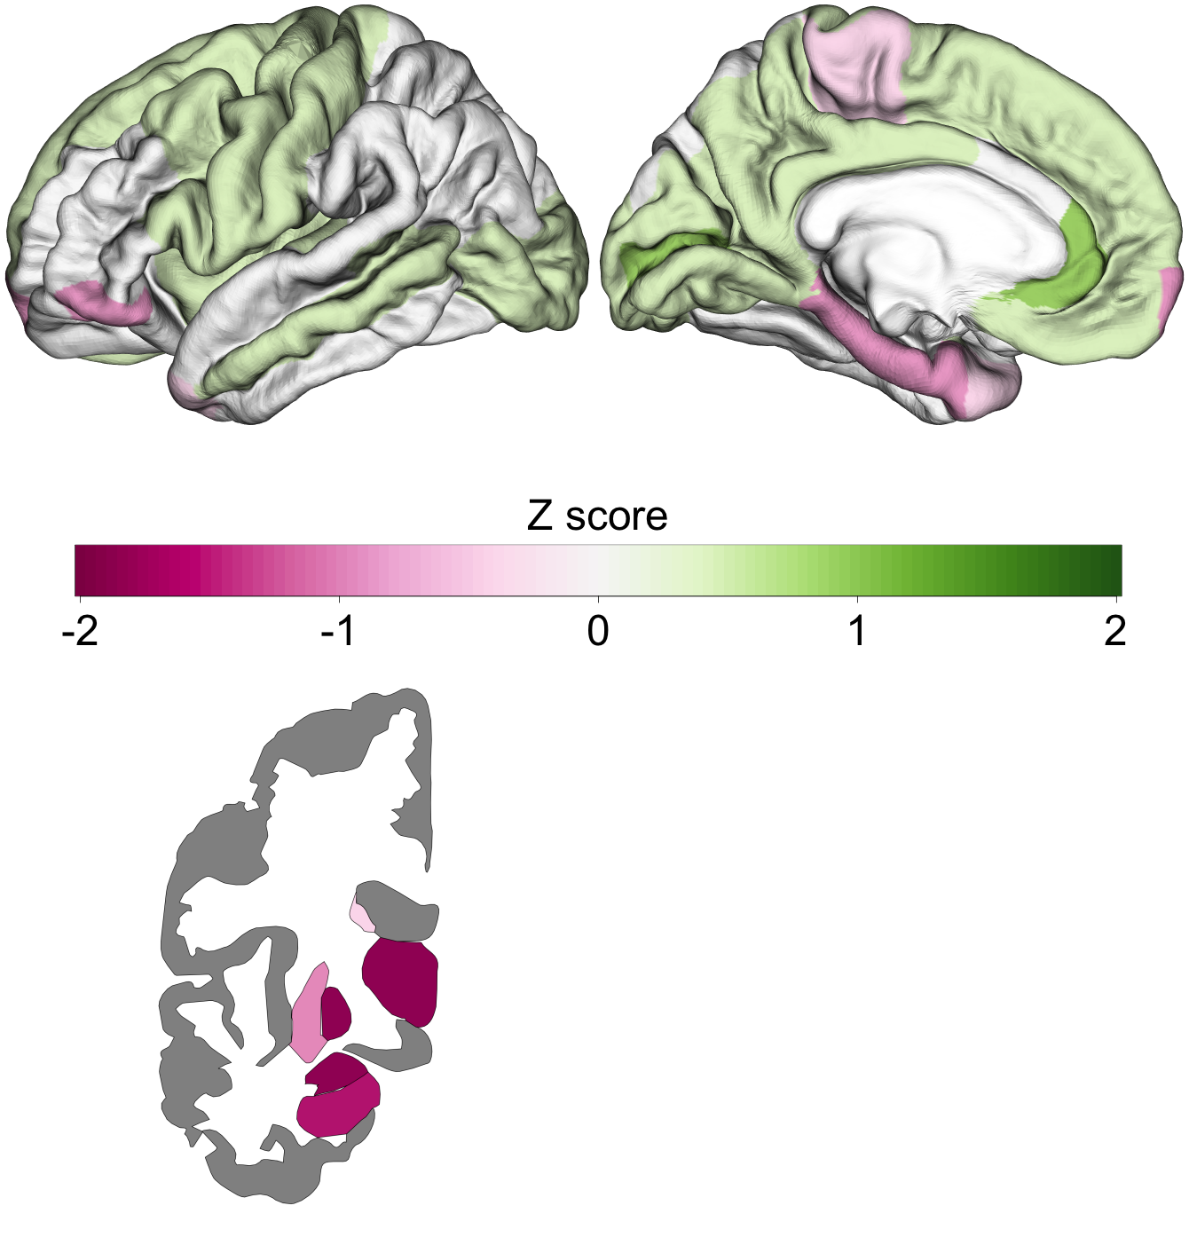
ADHD – UP-Regulated genes
Enigma Cohen’s d
Gene Expression TPRS Score
10%
5%
1%

Slide 16
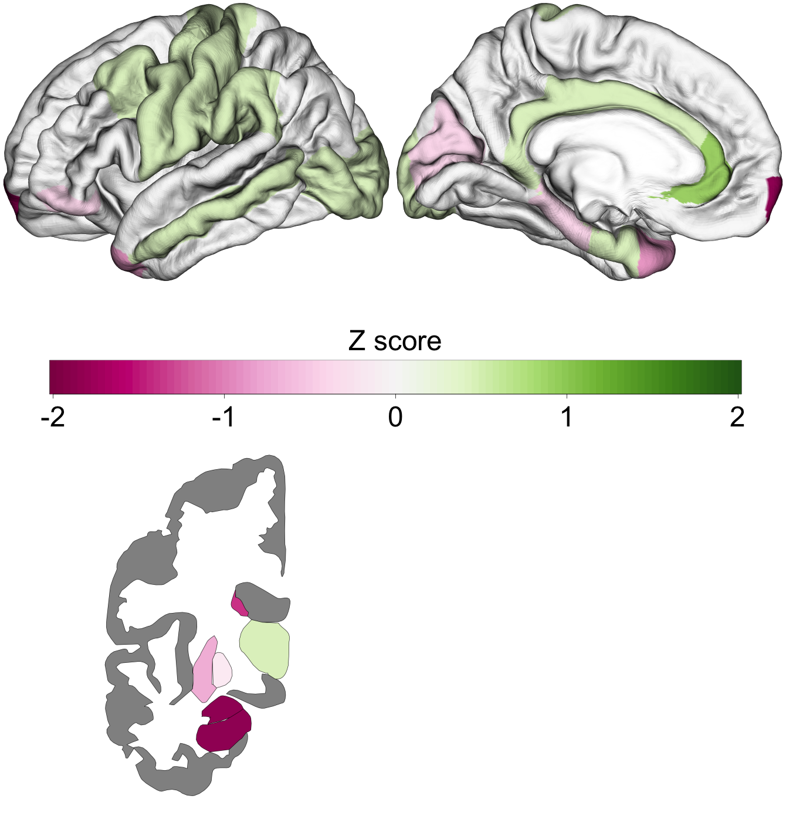
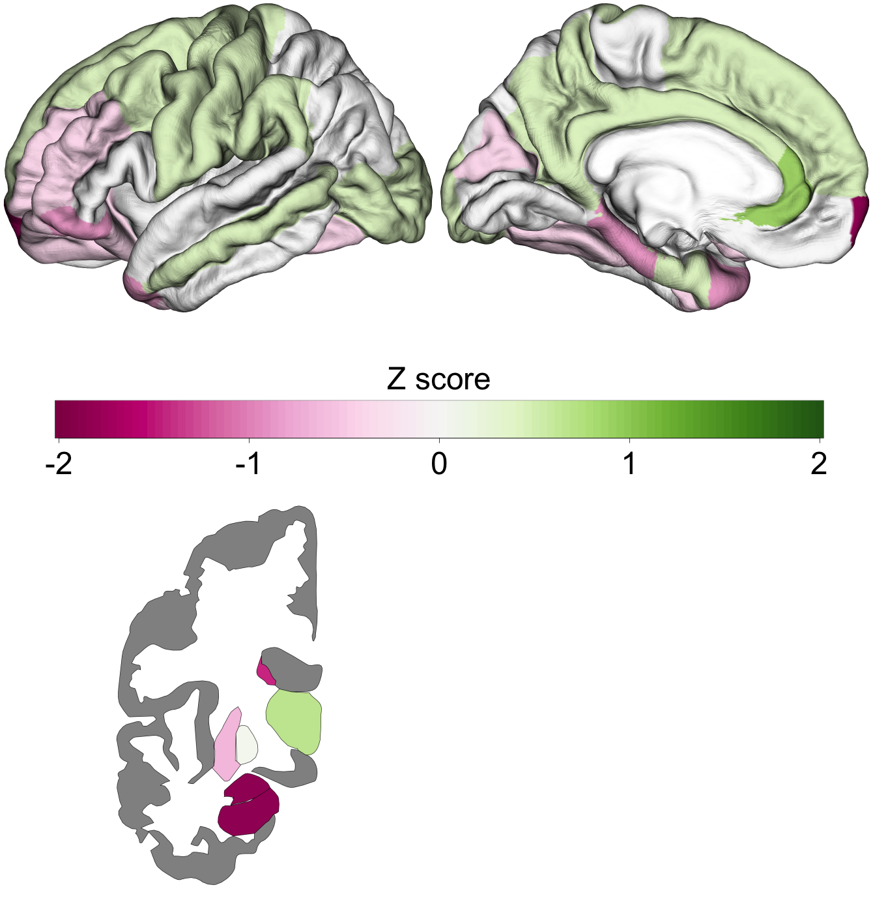
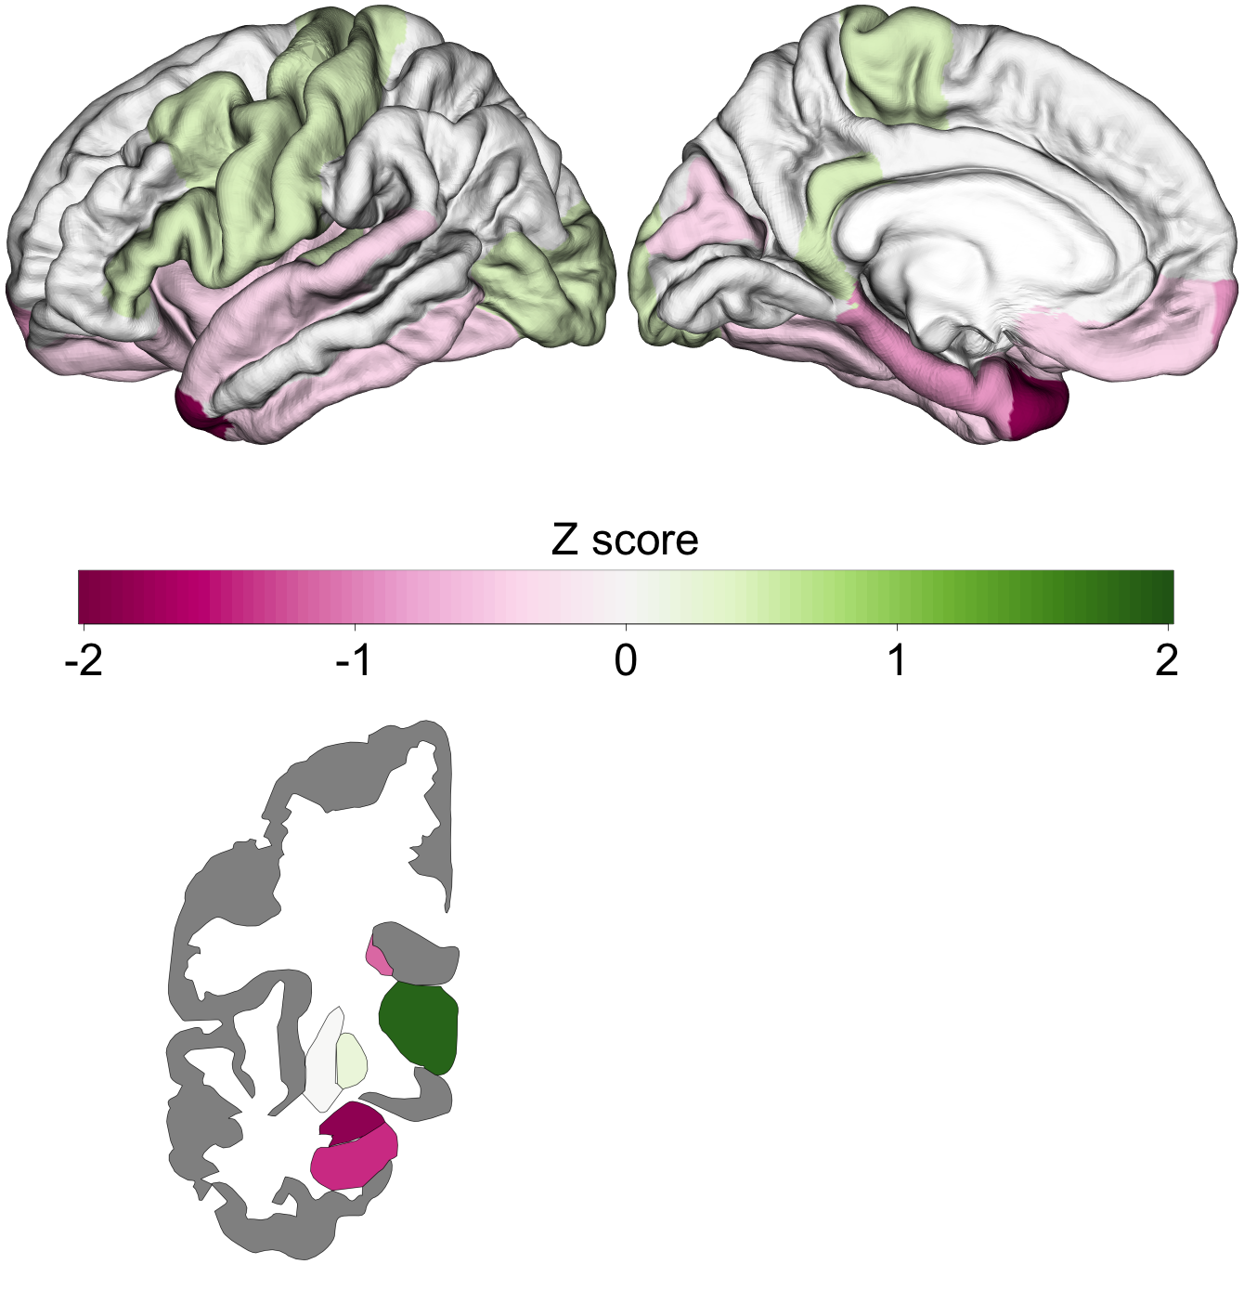
ADHD – DOWN-Regulated genes
Enigma Cohen’s d
Gene Expression TPRS Score
10%
5%
1%

Slide 17
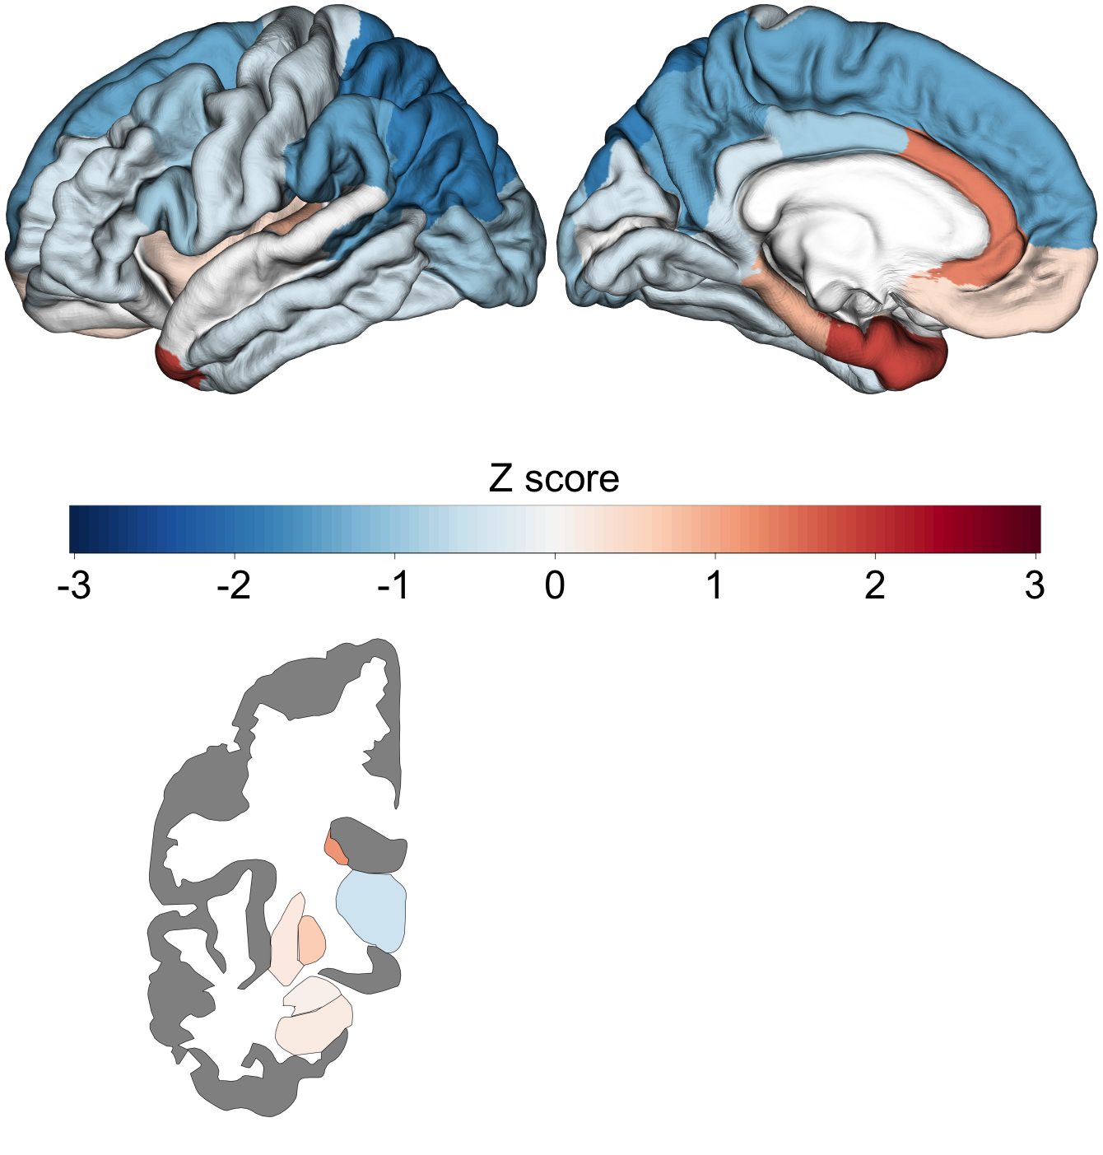
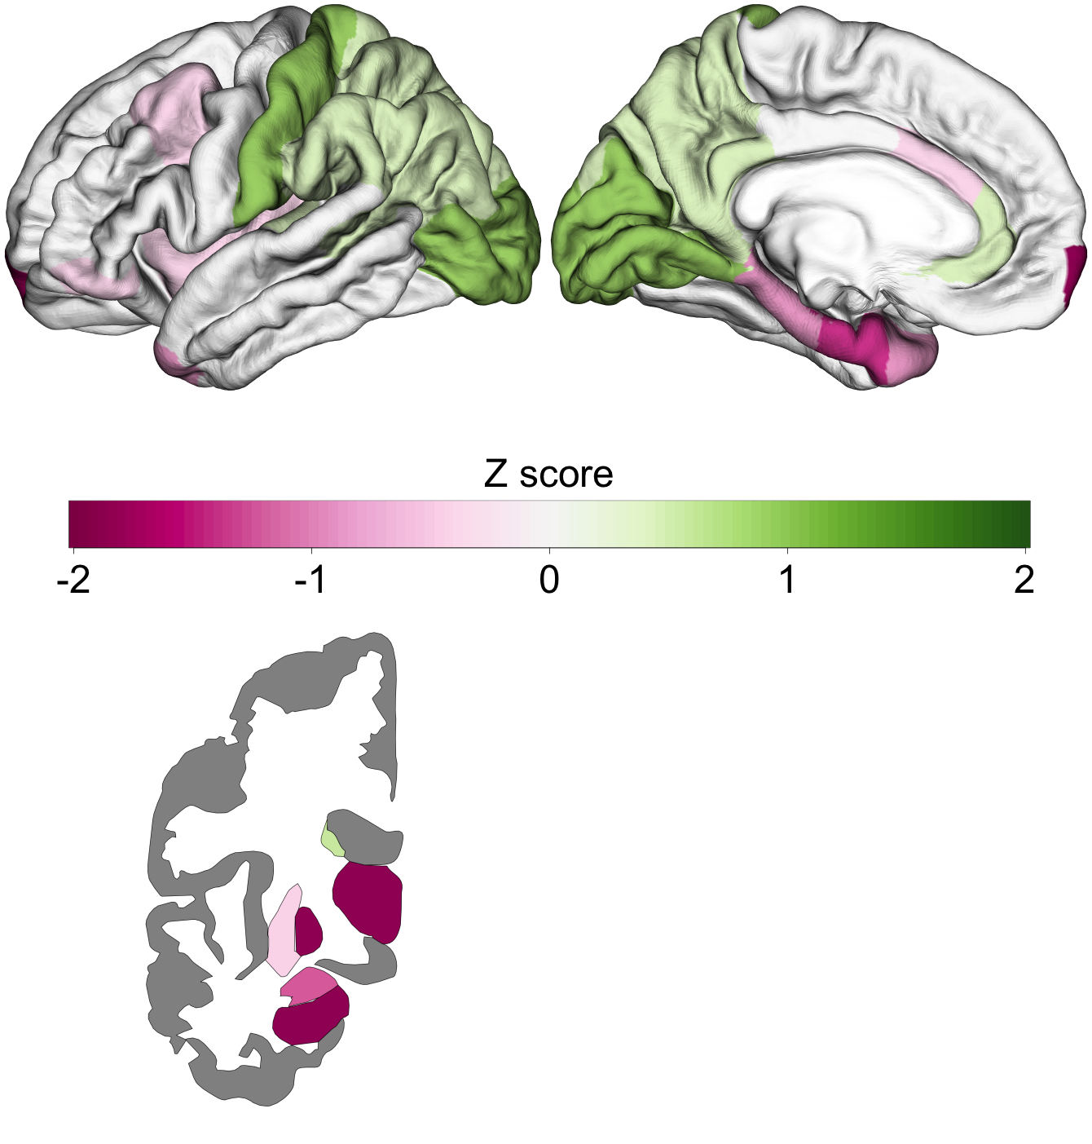

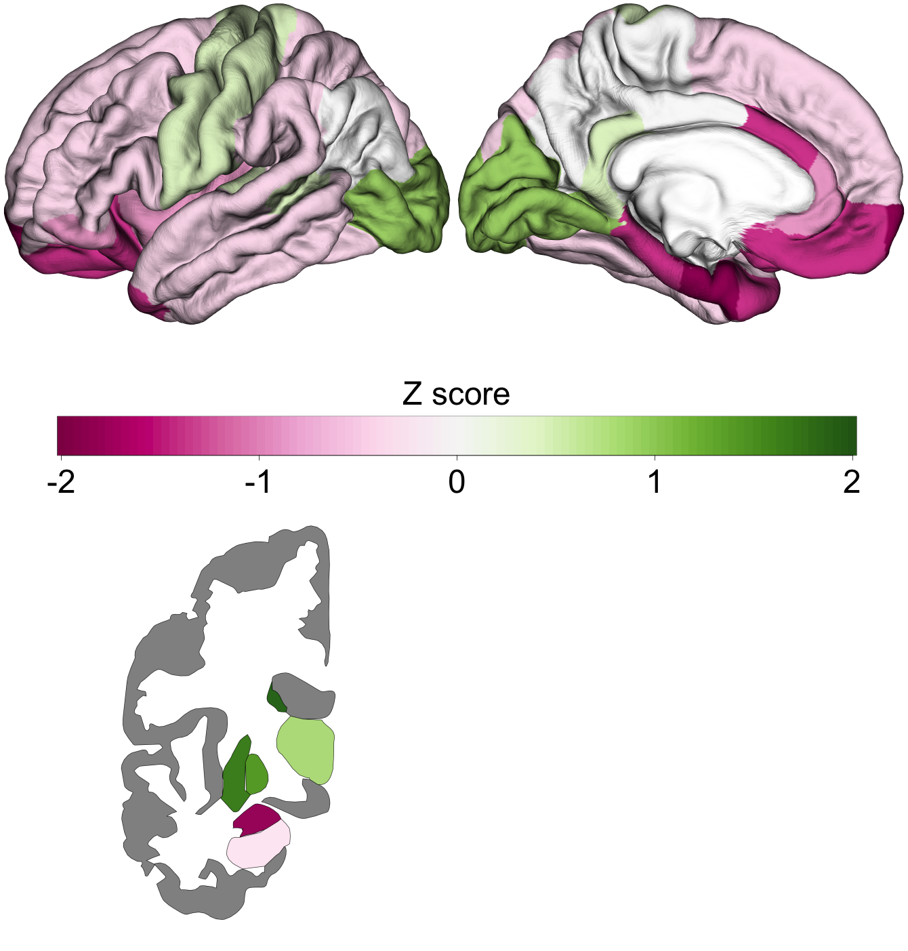
AN – UP- & Down-Regulated genes
Enigma Cohen’s d
Gene Expression TPRS Score
10%
5%
1%

Slide 18
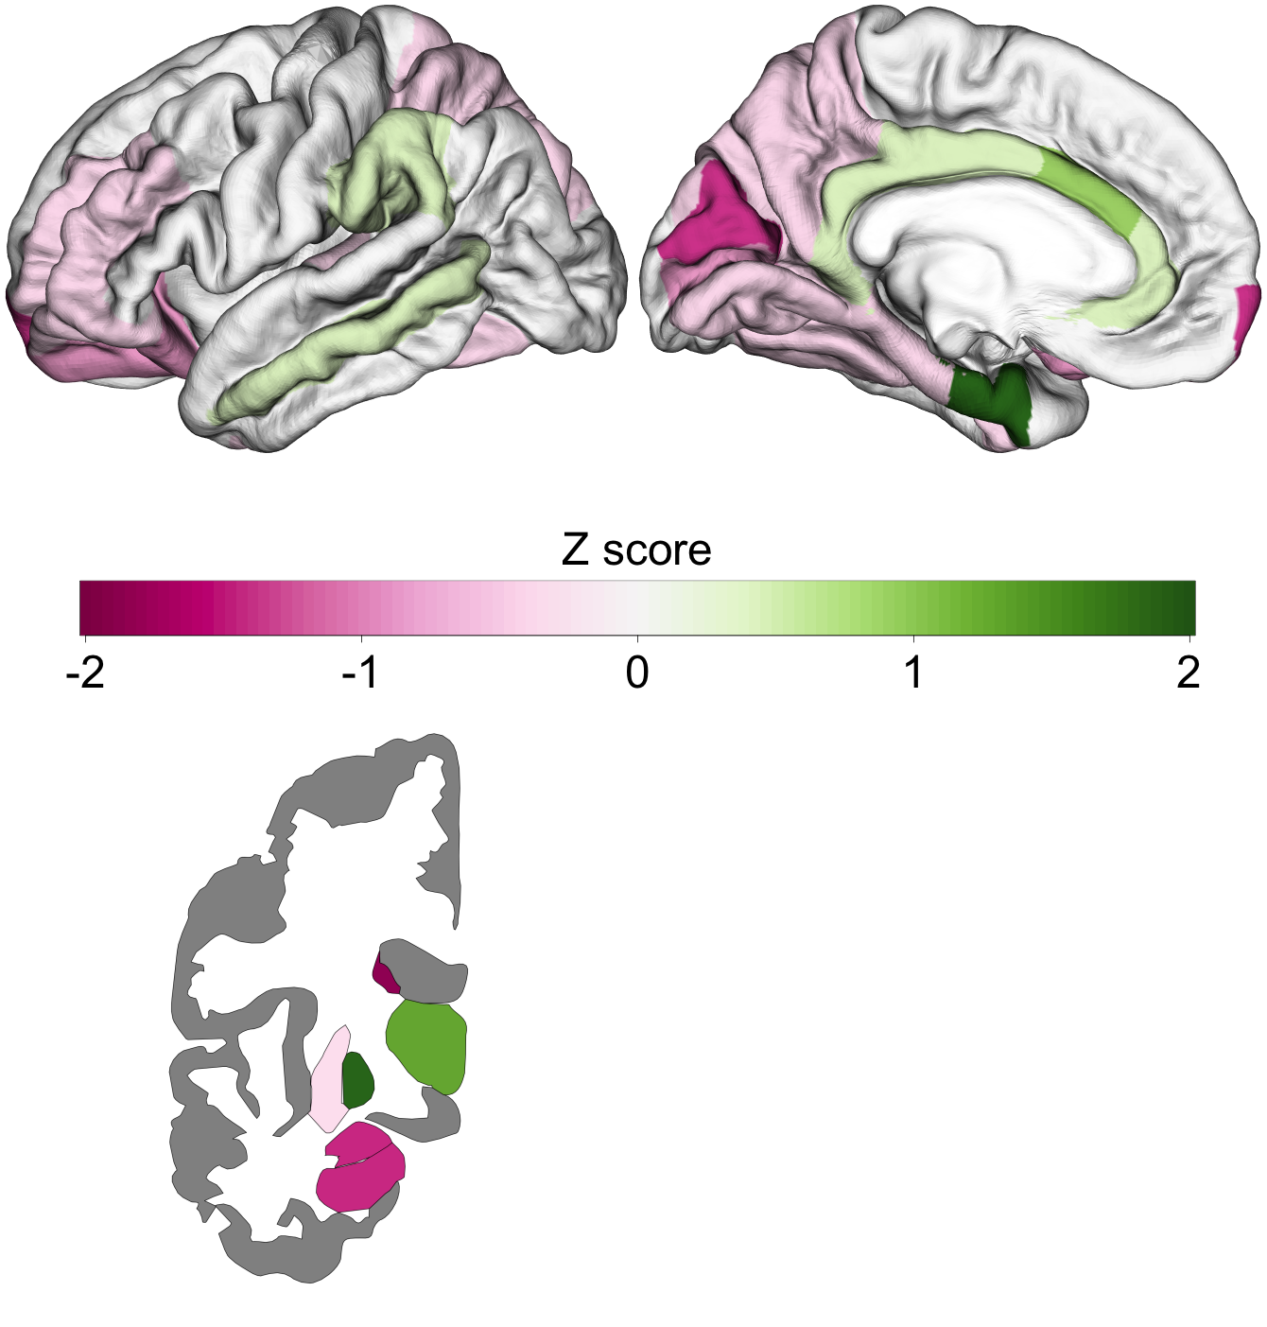
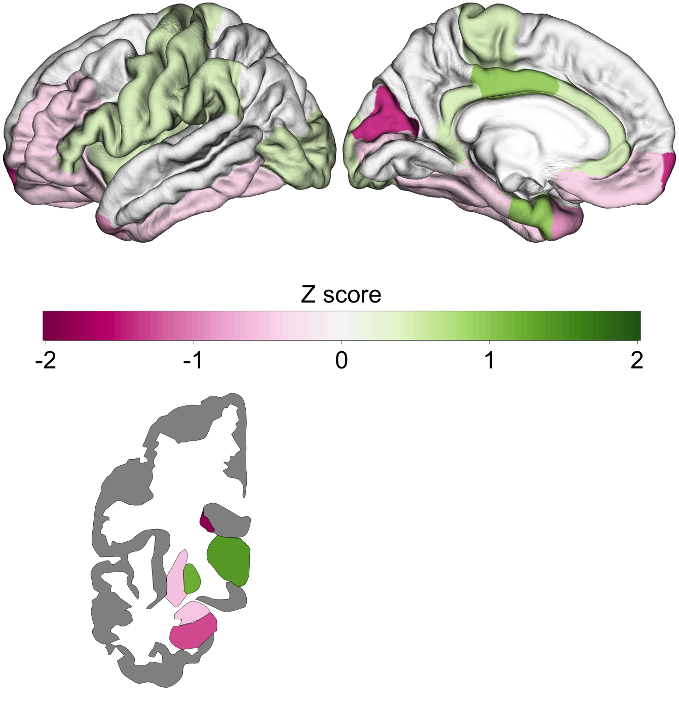
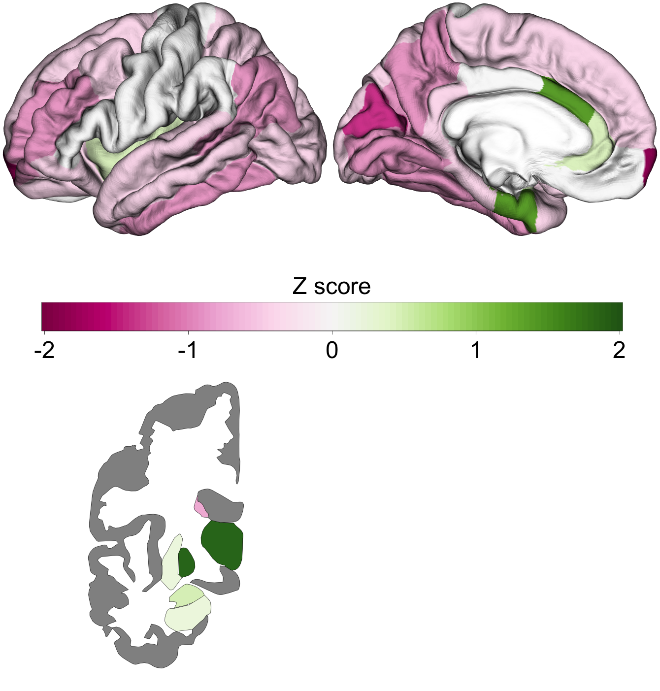
AN – UP-Regulated genes
Enigma Cohen’s d
Gene Expression TPRS Score
10%
5%
1%

Slide 19
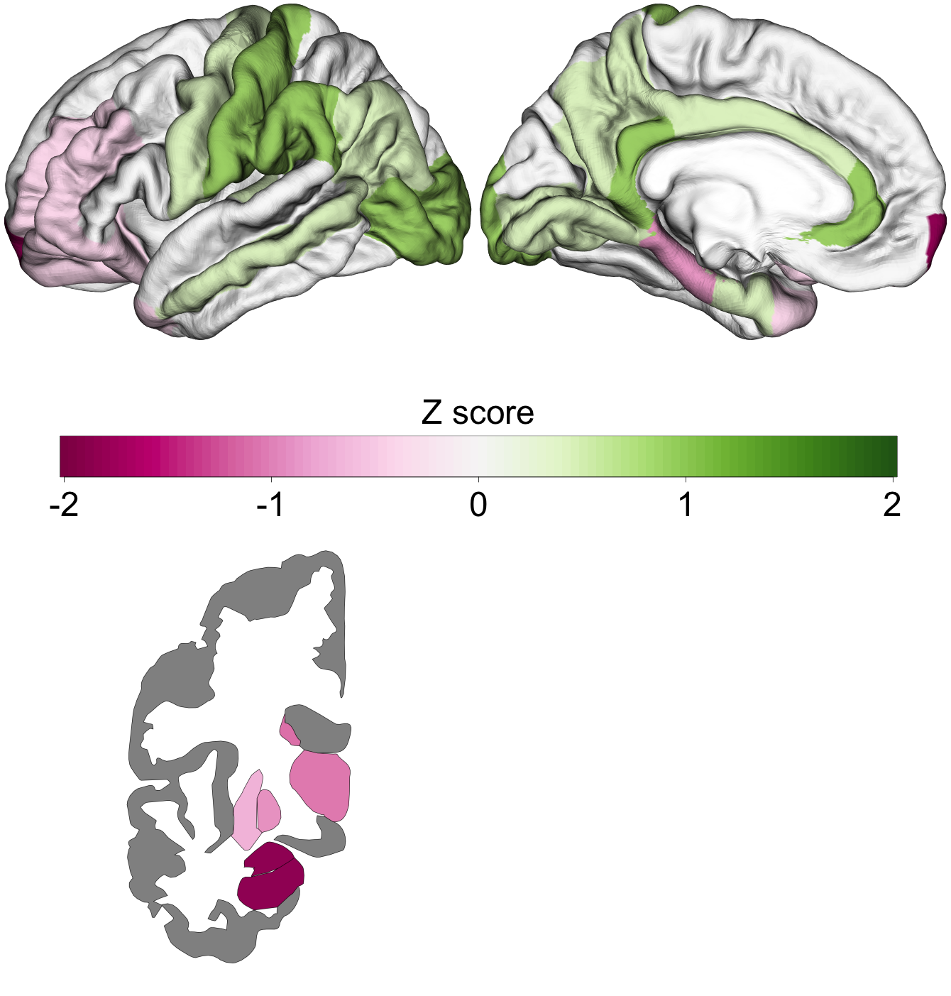
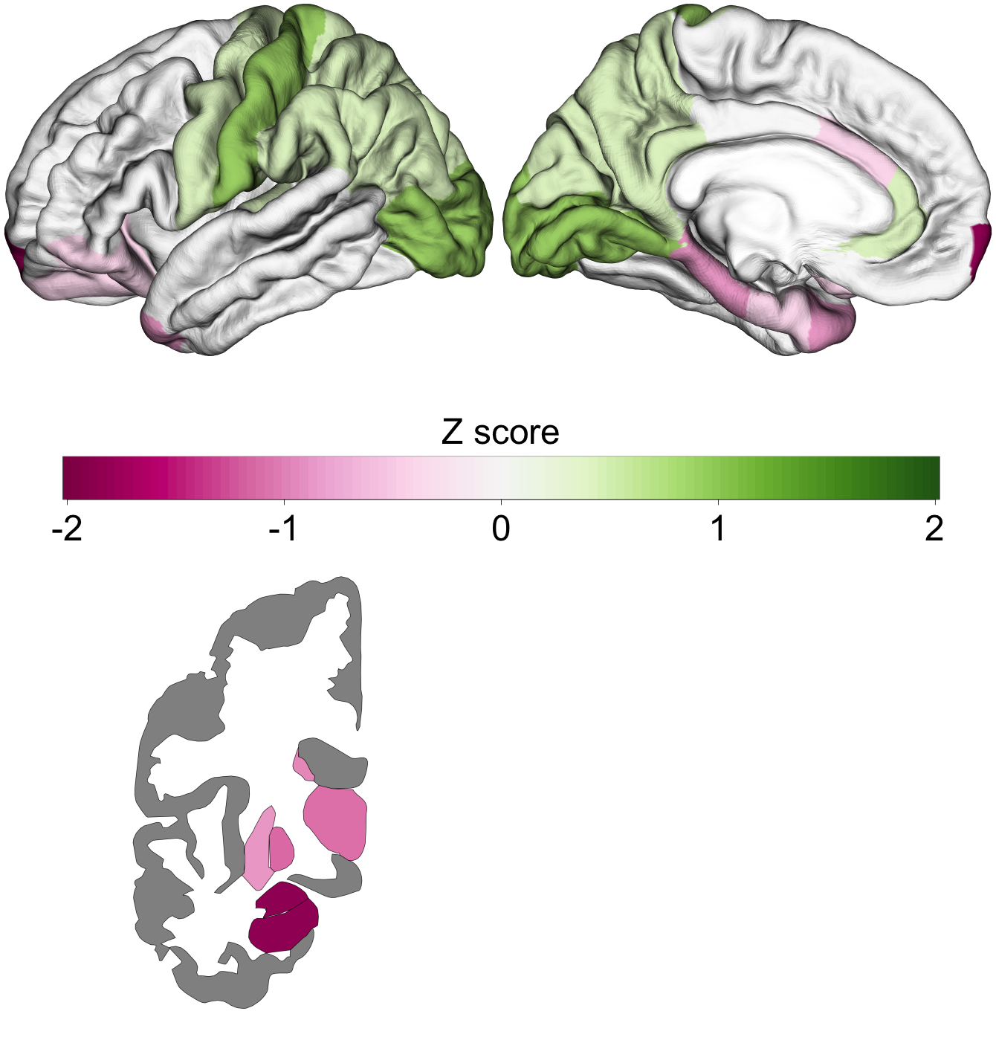
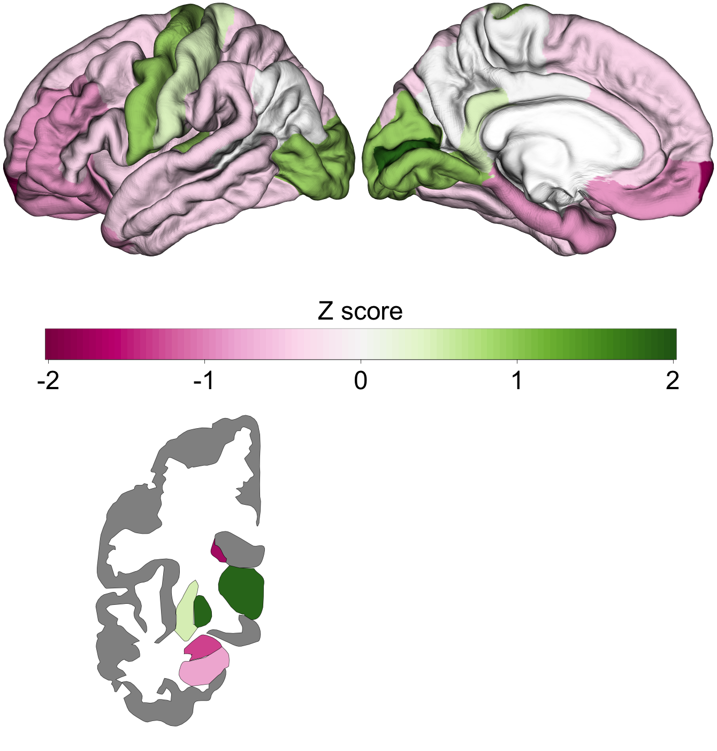
AN – DOWN-Regulated genes
Enigma Cohen’s d
Gene Expression TPRS Score
10%
5%
1%

Slide 20
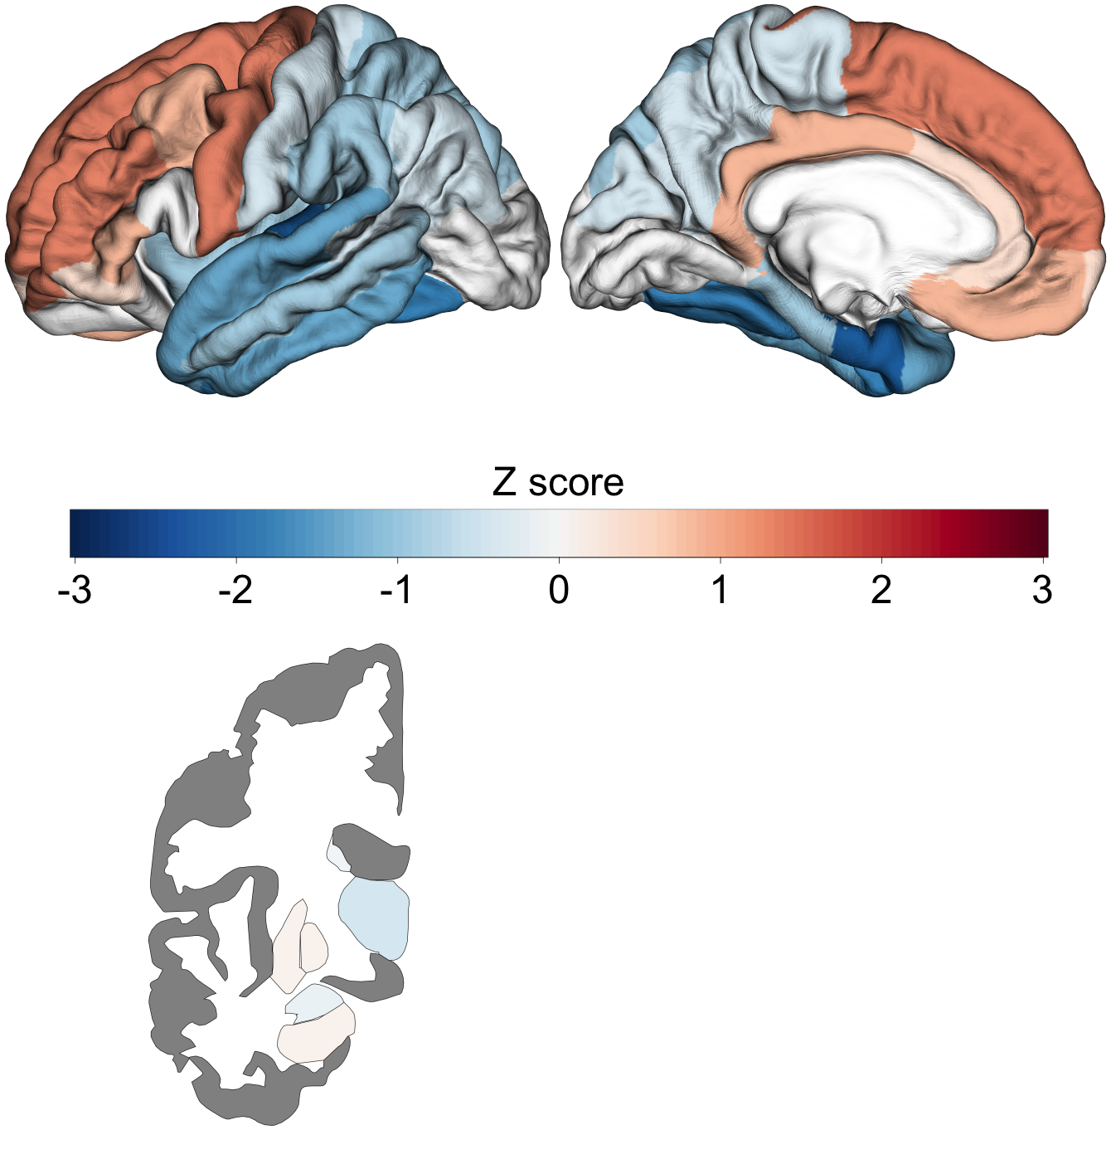
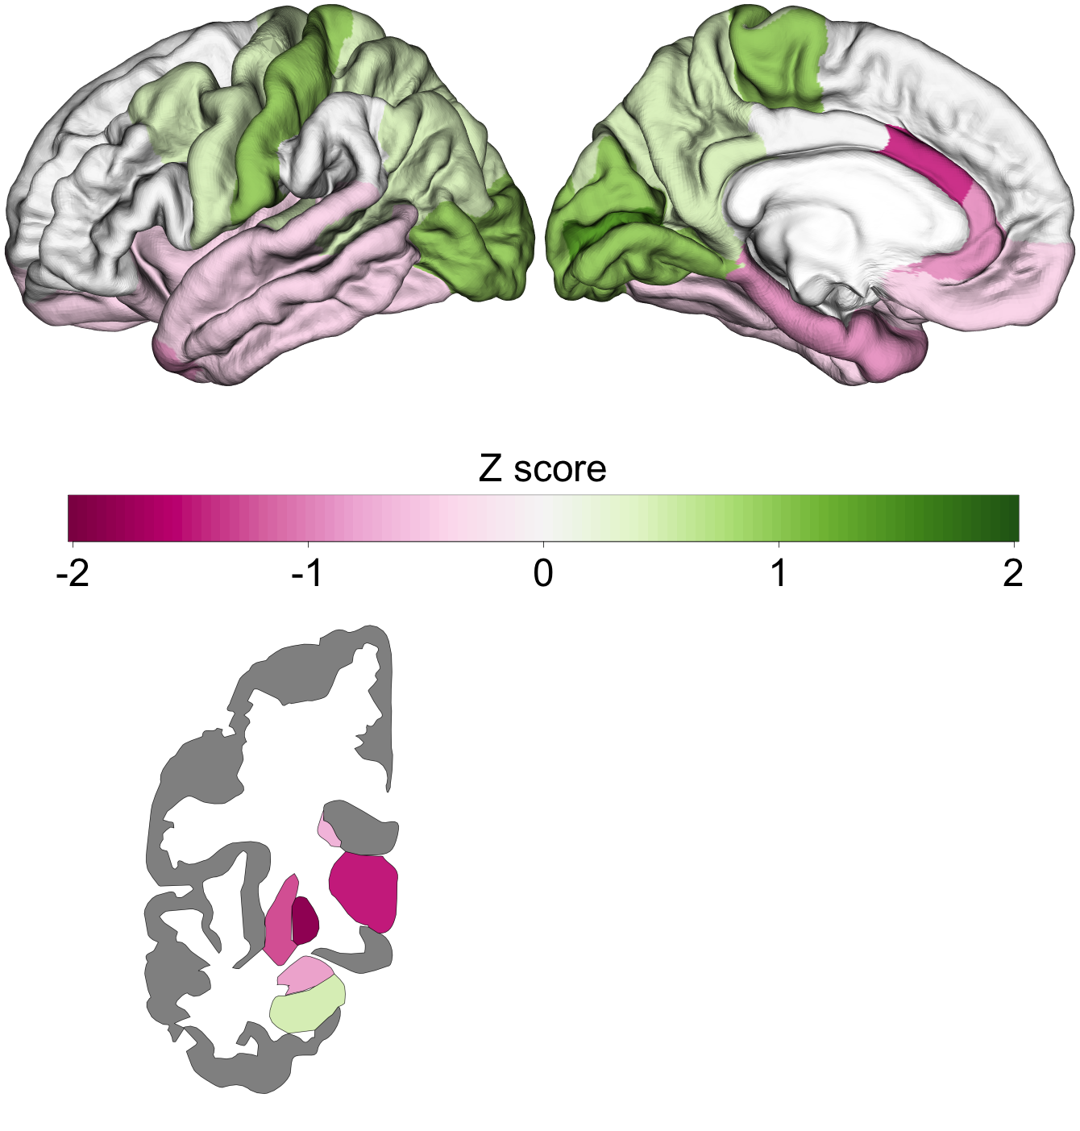
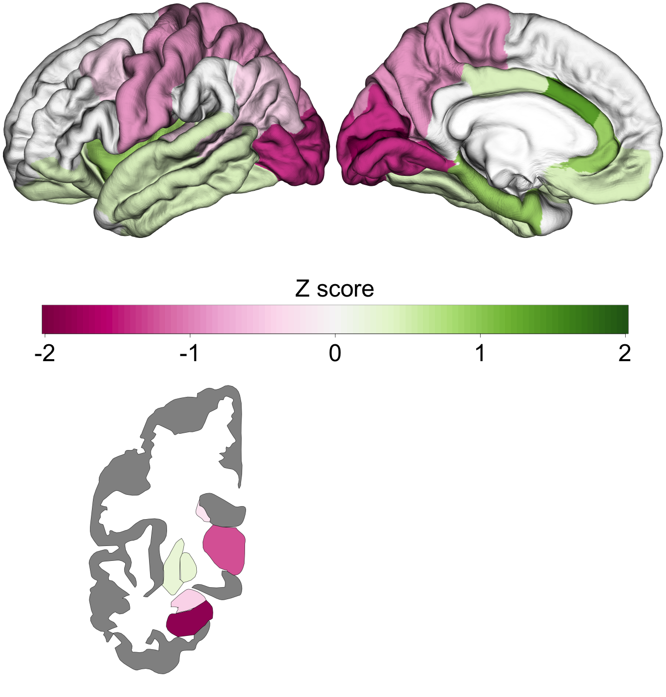
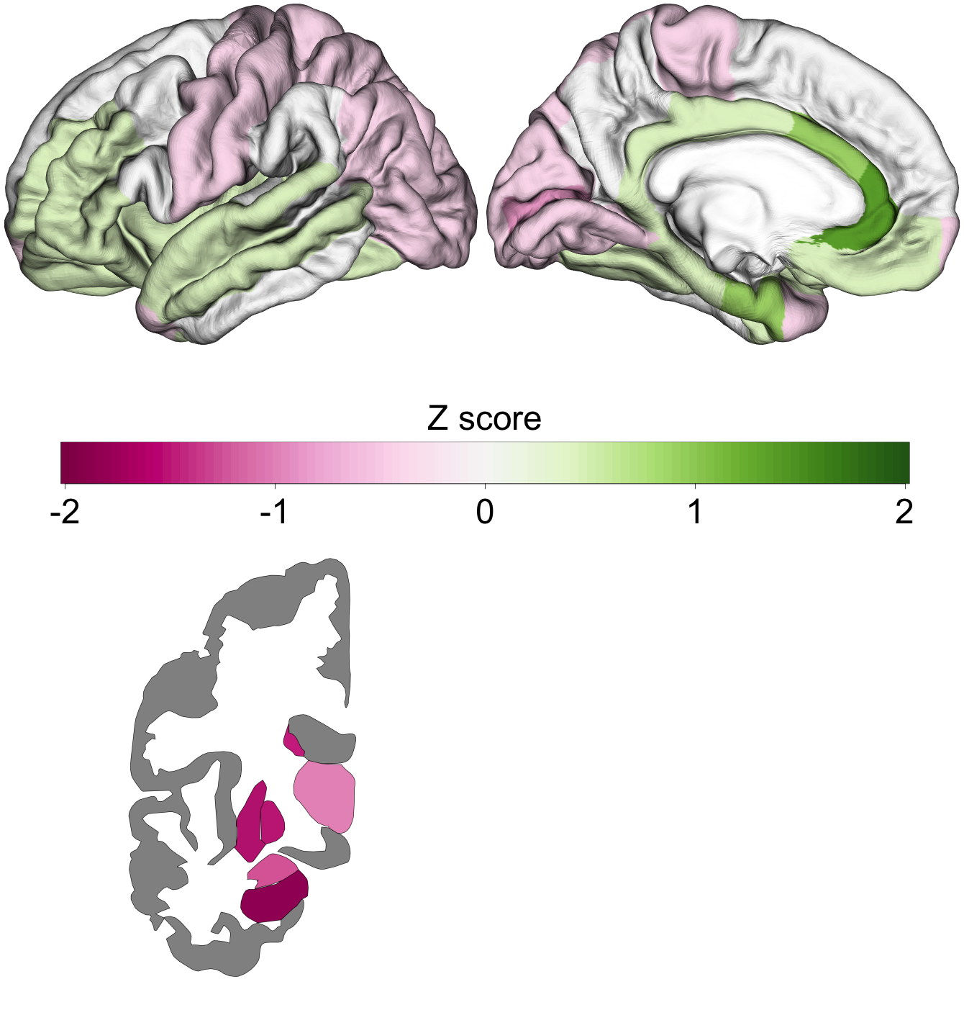
ASD – UP- & Down-Regulated genes
Enigma Cohen’s d
Gene Expression TPRS Score
10%
5%
1%

Slide 21
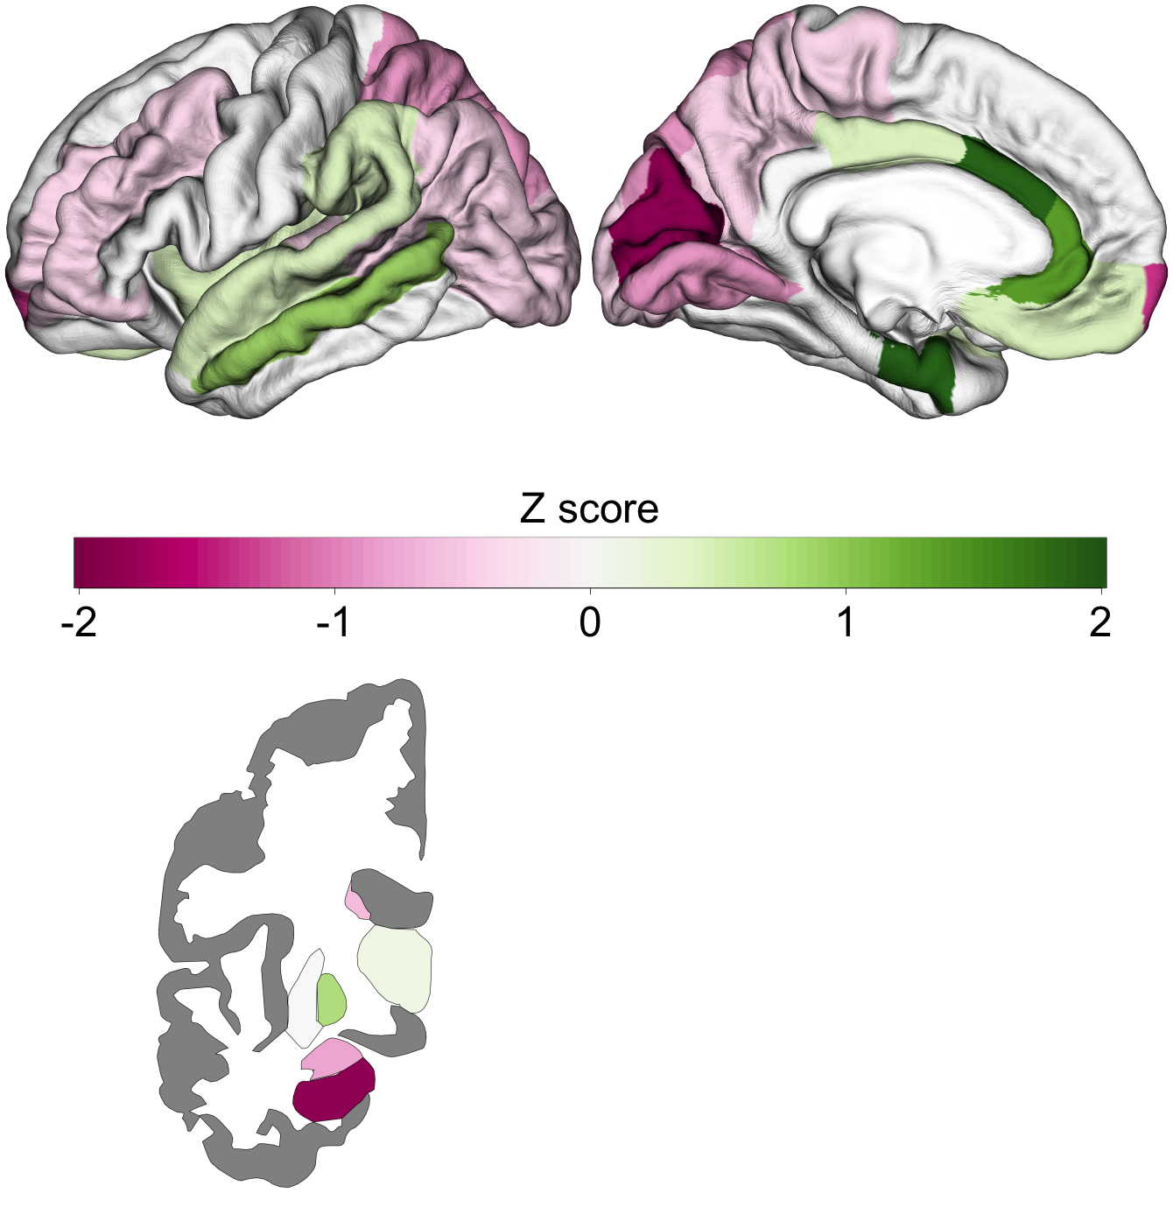
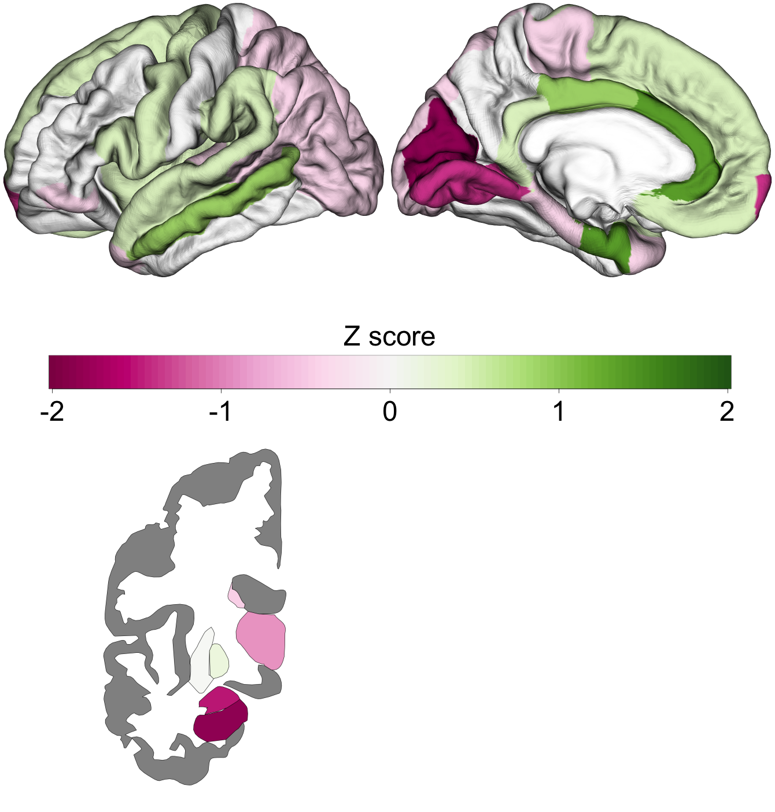
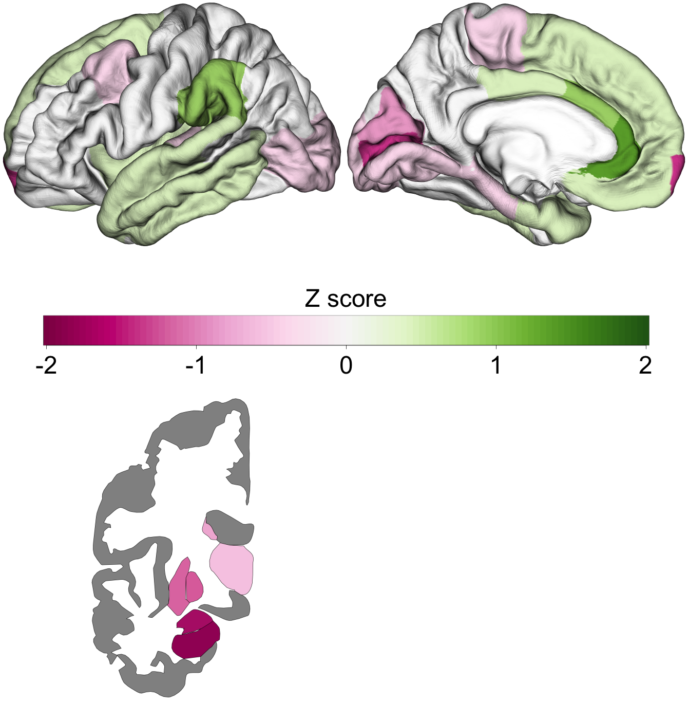
ASD – UP-Regulated genes
Enigma Cohen’s d
Gene Expression TPRS Score
10%
5%
1%

Slide 22
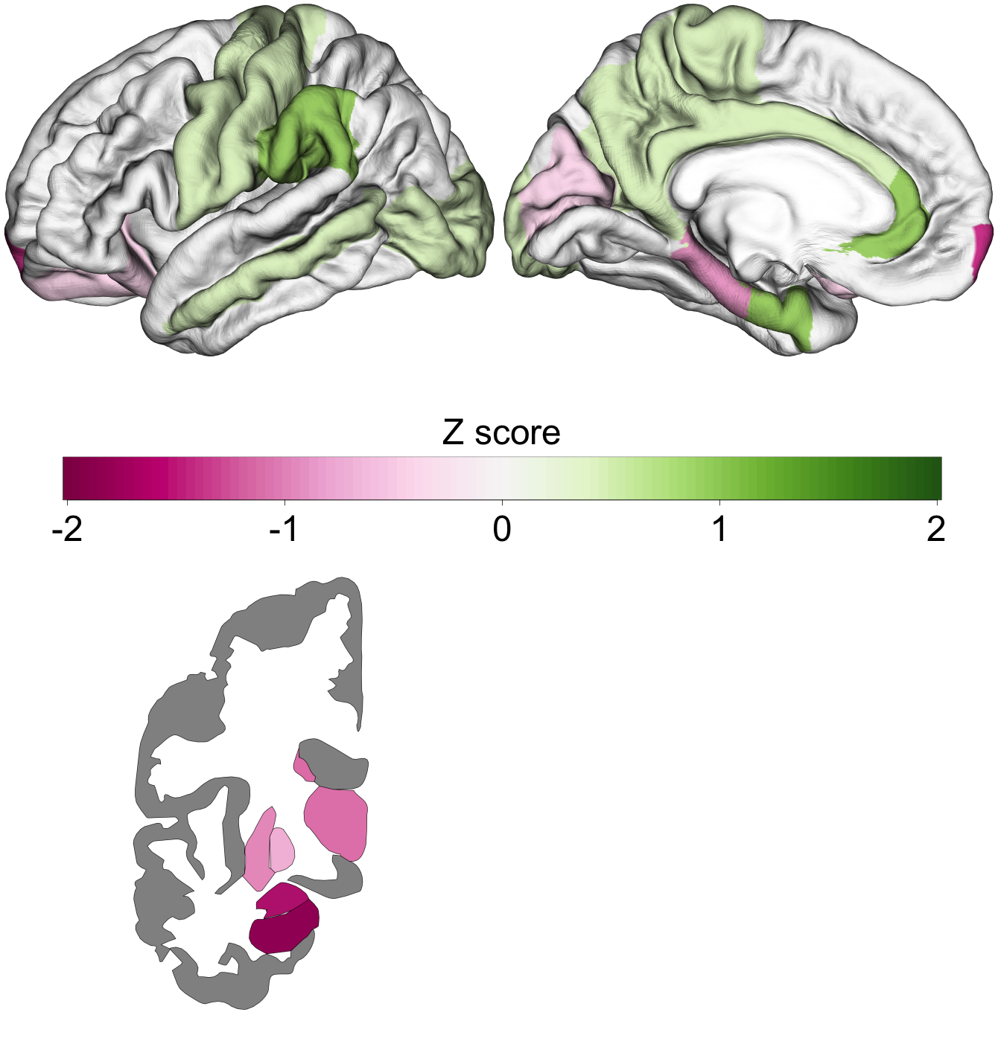
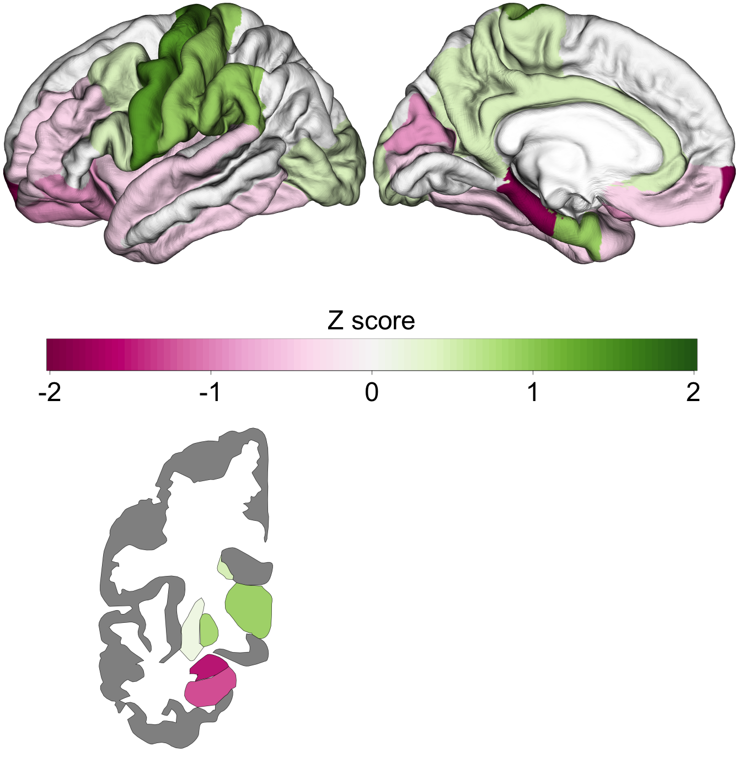
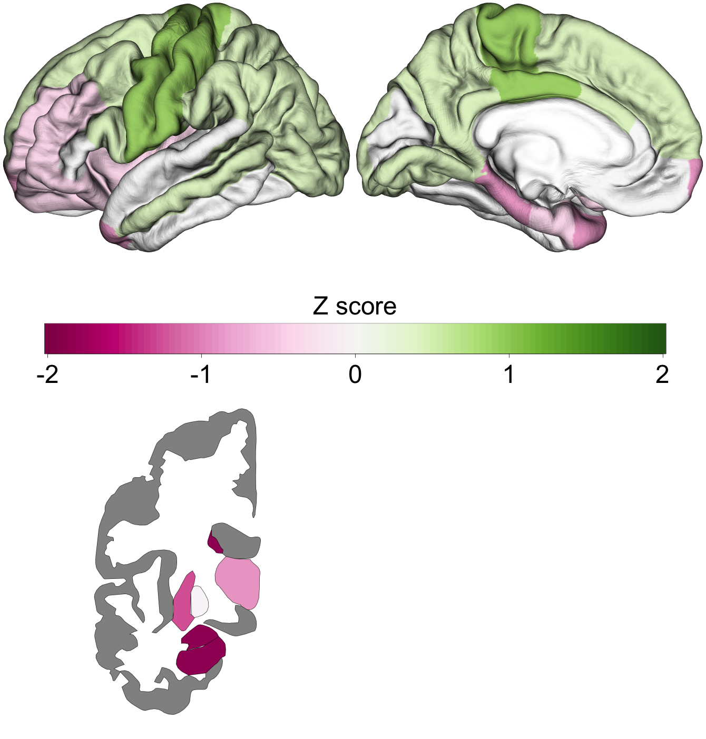
ASD – DOWN-Regulated genes
Enigma Cohen’s d
Gene Expression TPRS Score
10%
5%
1%

Slide 23
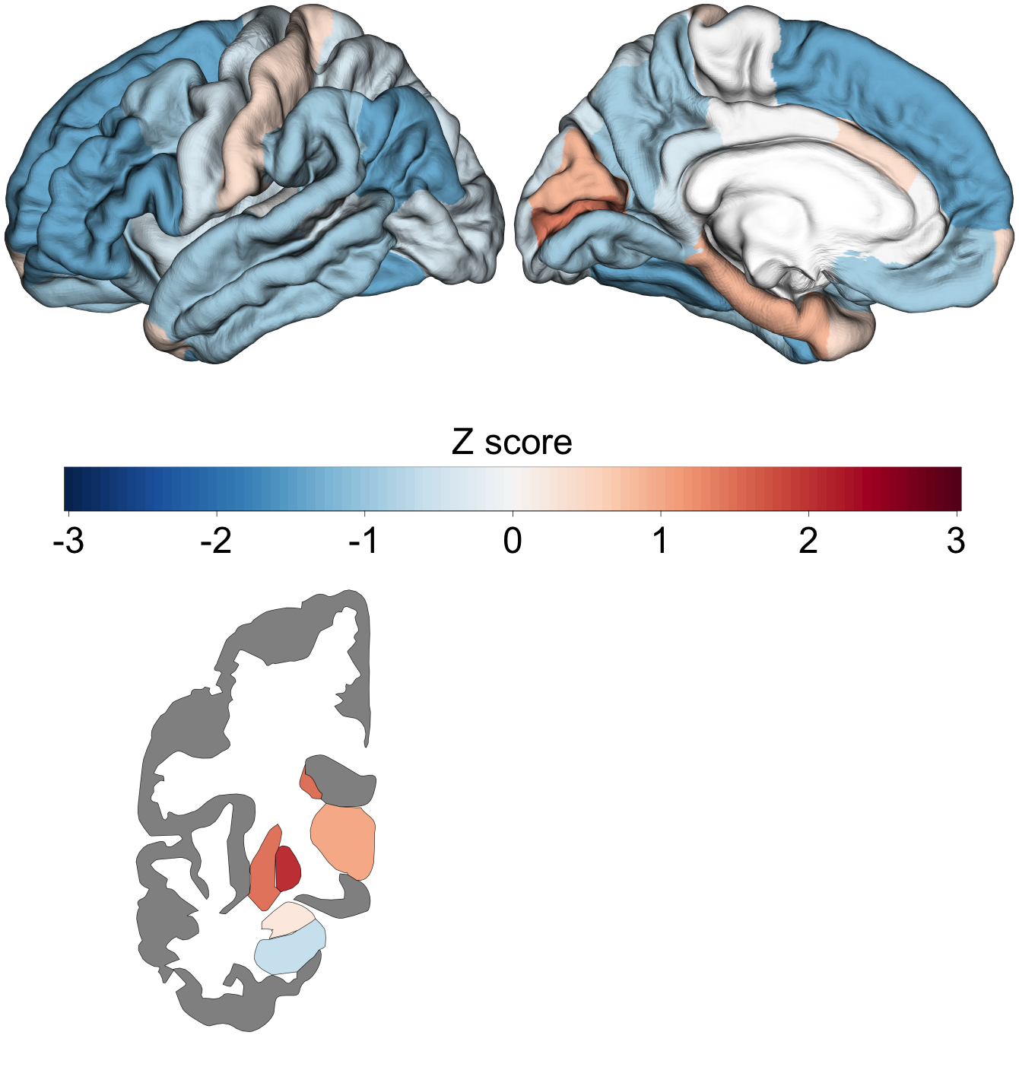
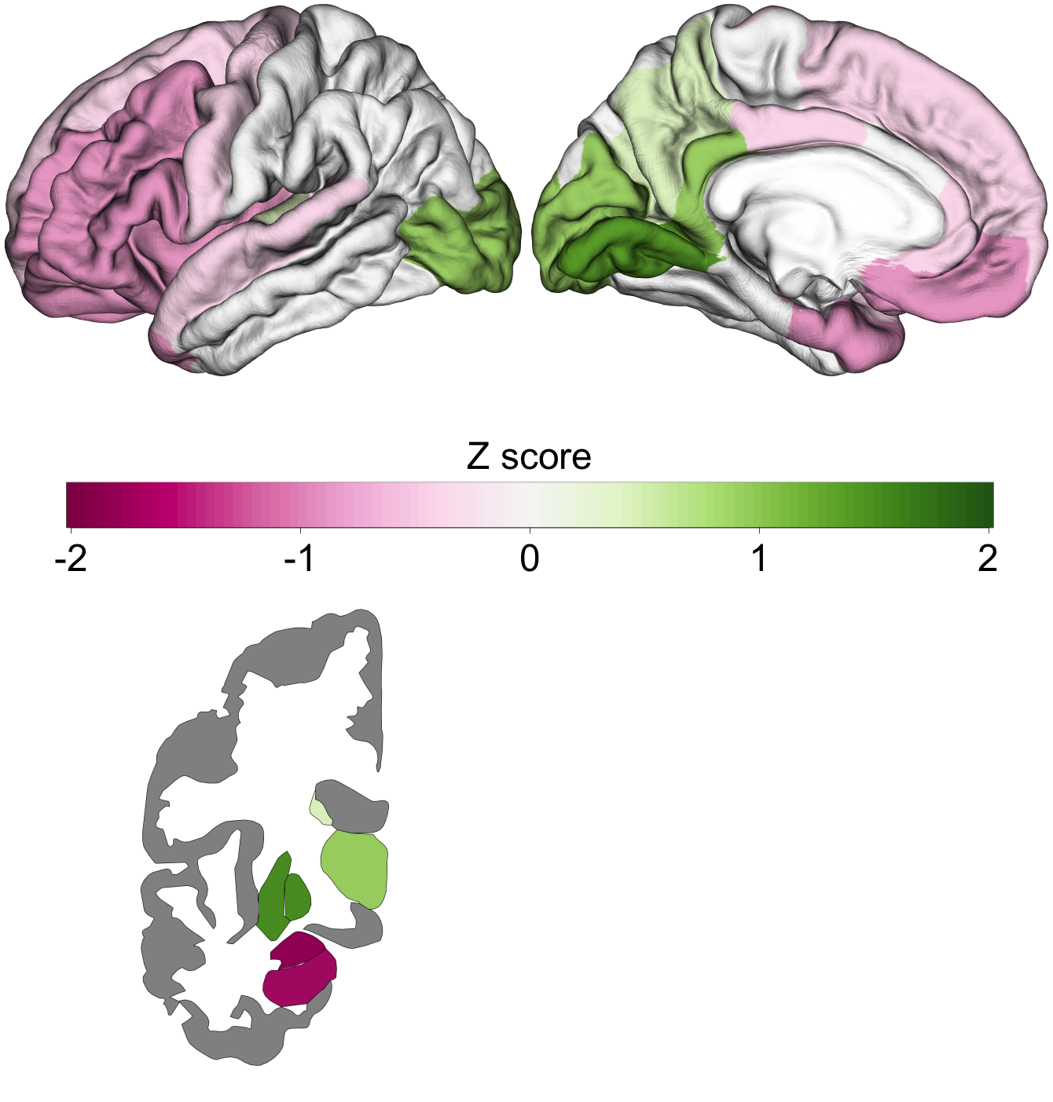
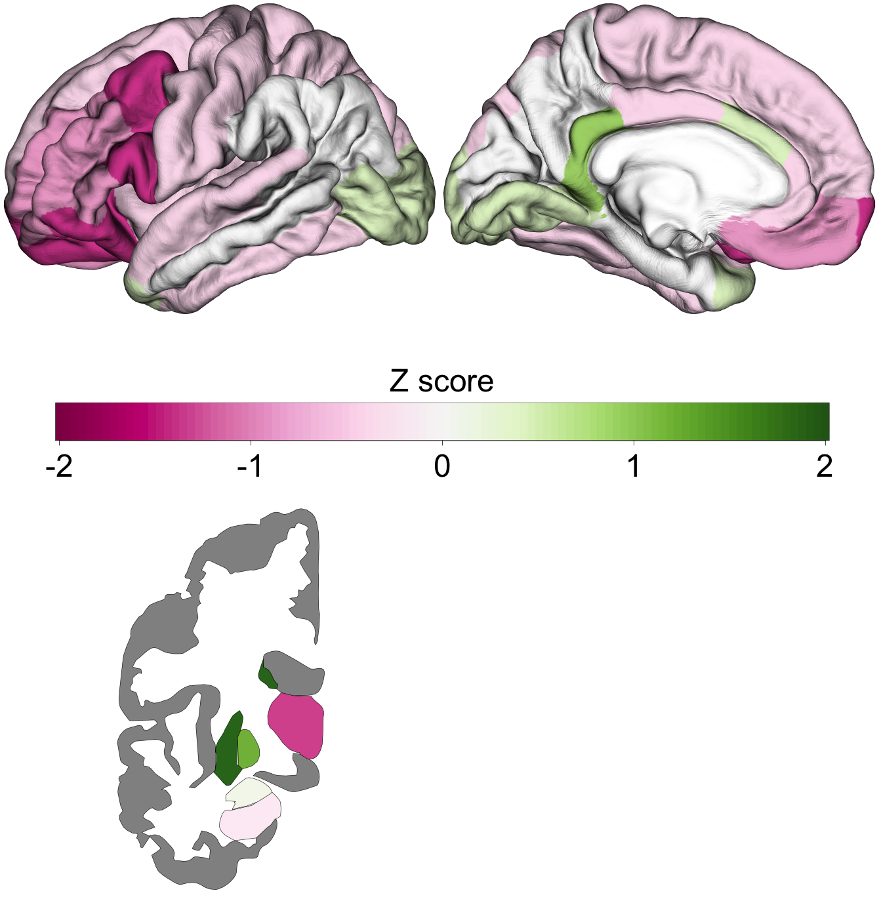
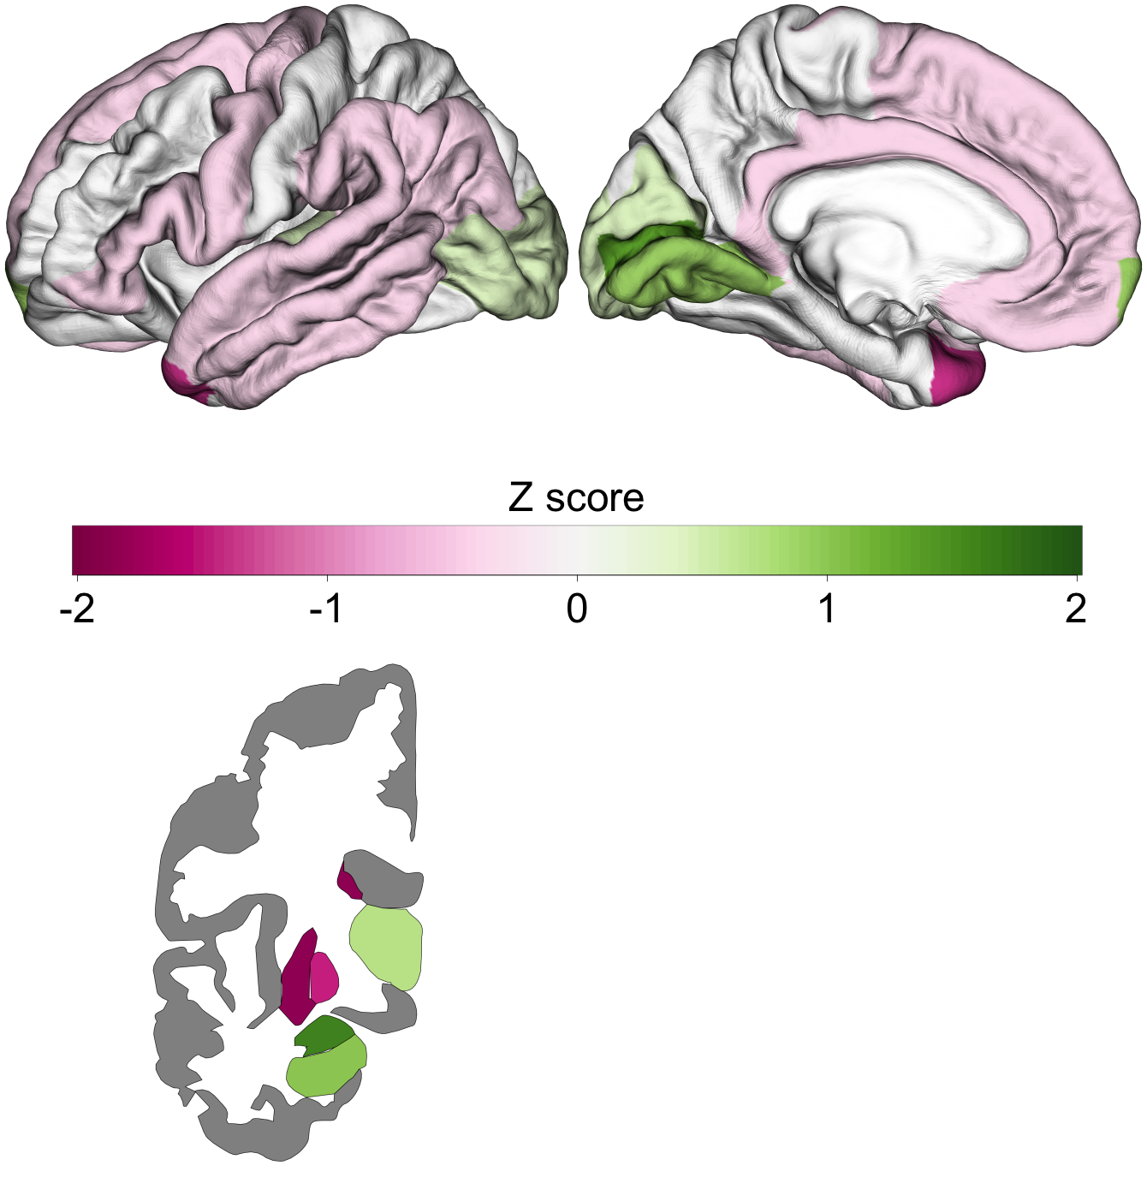
BD – UP- & Down-Regulated genes
Enigma Cohen’s d
Gene Expression TPRS Score
10%
5%
1%

Slide 24



BD – UP-Regulated genes
Enigma Cohen’s d
Gene Expression TPRS Score
10%
5%
1%

Slide 25



BD – DOWN-Regulated genes
Enigma Cohen’s d
Gene Expression TPRS Score
10%
5%
1%

Slide 26




MDD – UP- & Down-Regulated genes
Enigma Cohen’s d
Gene Expression TPRS Score
10%
5%
1%

Slide 27



MDD – UP-Regulated genes
Enigma Cohen’s d
Gene Expression TPRS Score
10%
5%
1%

Slide 28



MDD – DOWN-Regulated genes
Enigma Cohen’s d
Gene Expression TPRS Score
10%
5%
1%

Slide 29




OCD – UP- & Down-Regulated genes
Enigma Cohen’s d
Gene Expression TPRS Score
10%
5%
1%

Slide 30



OCD – UP-Regulated genes
Enigma Cohen’s d
Gene Expression TPRS Score
10%
5%
1%

Slide 31



OCD – DOWN-Regulated genes
Enigma Cohen’s d
Gene Expression TPRS Score
10%
5%
1%

Slide 32




SCZ – UP- & Down-Regulated genes
Enigma Cohen’s d
Gene Expression TPRS Score
10%
5%
1%

Slide 33



SCZ – UP-Regulated genes
Enigma Cohen’s d
Gene Expression TPRS Score
10%
5%
1%

Slide 34



SCZ – DOWN-Regulated genes
Enigma Cohen’s d
Gene Expression TPRS Score
10%
5%
1%

Slide 35

TPRS SCORE Correlation with Imaging up- and down-regulated genes (signed z-score)

Slide 36


TPRS SCORE Correlation with Imaging up-regulated genes Only (positive z-score)

Slide 37
TPRS SCORE Correlation with Imaging down-regulated genes only (negative z-score)

Slide 38




